Slide 1
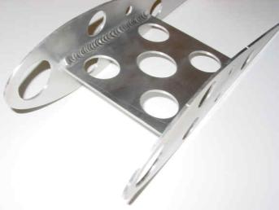
CREO PARAMETRIC – WELD DESIGN
Accurately define weld geometry and the associated weld fabrication documentation
Who Needs It?
Customers that need to define and capture the weld fabrication process and manufacturing requirements
Business Value
Reduce product costs
Design to realize price premium
Reduce product development cost
Process Improvement
3D Weld definition (modeling)
2D Weld documentation (detailing)
Technology/ Capability
3D welds are required to support downstream activities
Reference weld geometry to create accurate structural analyses
Perform accurate mass properties and interference checking
Accurately assess costs and time estimates (manufacturing)
Accurately create weld symbols and weld fabrication documentation

