Slide 1
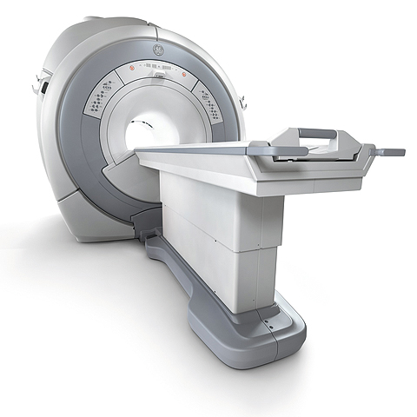
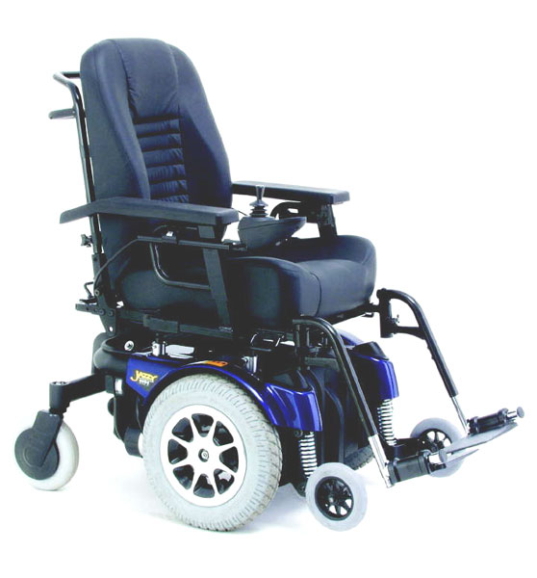
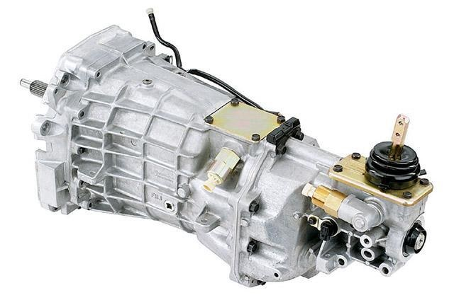
CREO PARAMETRIC − UNITE TECHNOLOGY
Capabilities to support multi-CAD Collaboration and Consolidation
Who Needs It?
Every customer that needs to integrate and work with design data from OEMs and outsourced design partners (components, subsystems, etc.)
The typical company uses an average of 2.7 CAD systems
Business Value
Reduce product cost
Reduce time-to-market
Reduce product development cost
Improve product quality and innovation
Process Improvement
Multi-CAD Design Collaboration
CAD Consolidation
Technology/ Capability
Easily integrate and work with data from any CAD source
Directly import CATIA V4/V5, SolidWorks, Solid Edge and Inventor formats
Directly open CATIA V4/V5, Siemens NX, SolidWorks and Inventor

