Slide 1
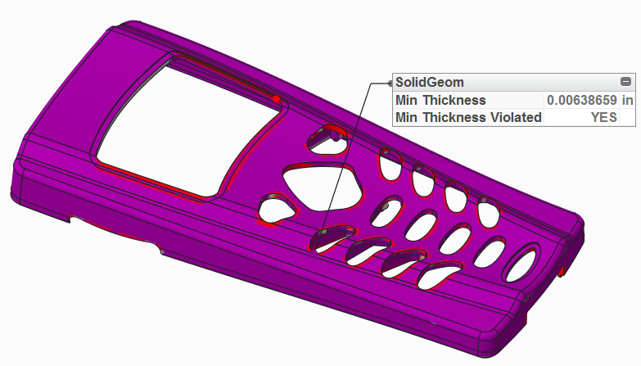
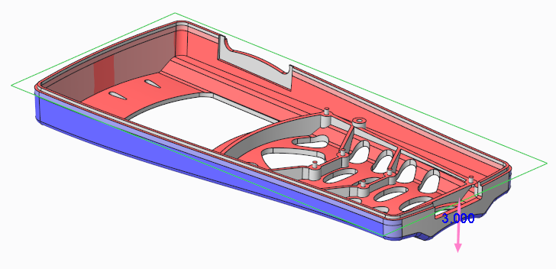
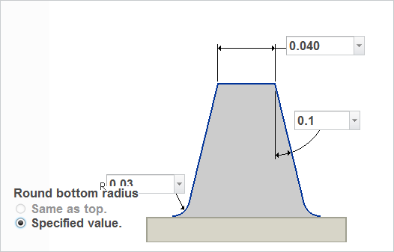
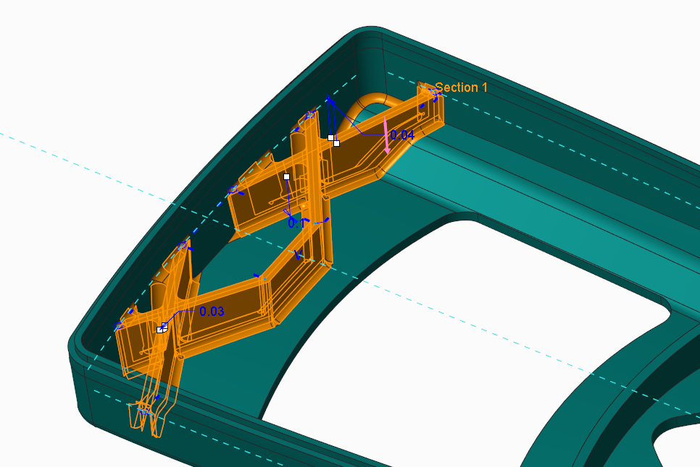
CREO PARAMETRIC – PLASTIC PART DESIGN
Specialized features to speed the creation and analysis of plastic and “thin walled” parts
Who Needs It?
Customers that design plastic parts and “thin walled” geometry
Business Value
Reduce product costs
Reduce time-to-market
Reduce product development cost
Process Improvement
3D plastic part design
Technology/ Capability
True 3D thickness checking
Fast analysis and verification of draft geometry
Specialized features to speed the creation of thin walled parts
Integral capabilities to analyze molding conditions and optimize geometry

