Slide 1
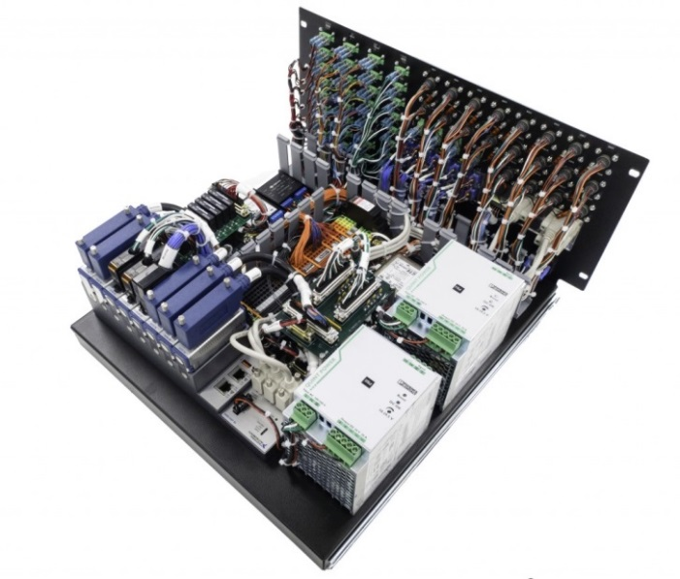
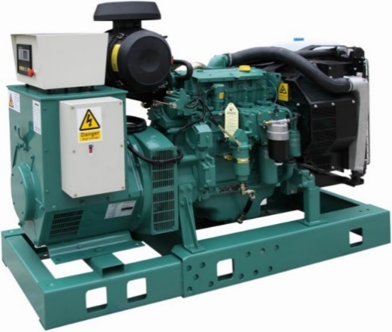
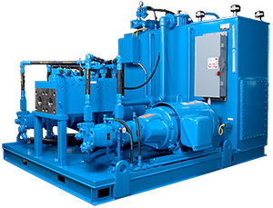
CREO PIPING AND CABLING DESIGN (PCX)
Create and optimize routings for cost, manufacturability and service
Who Needs It?
Any customer that requires integral 3D routing capabilities to optimize manufacturing, cost and serviceability
Business Value
Reduce time-to-market
Reduce product development cost
Lower lifecycle cost (optimize routings for service and manufacturability)
Process Improvement
3D cable and pipe routing and optimization
Verification and validation (2D schematic logic)
Automated creation of manufacturing deliverables
Technology/ Capability
Automated routing referencing 2D Schematic logic
Easily visualize and edit using drag handles and on-the-fly editing
Ability to compare/validate 3D data against 2D schematic logic
Fast creation of fully associative drawings and manufacturing deliverables
Notes:
.

