Slide 1
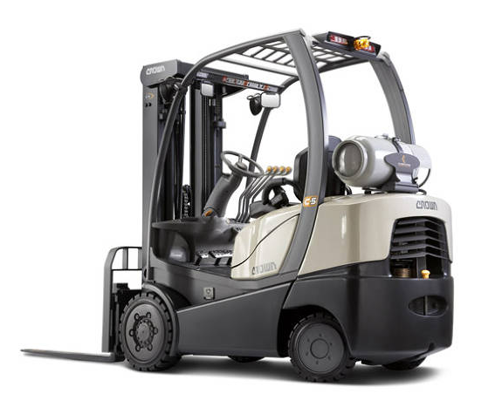
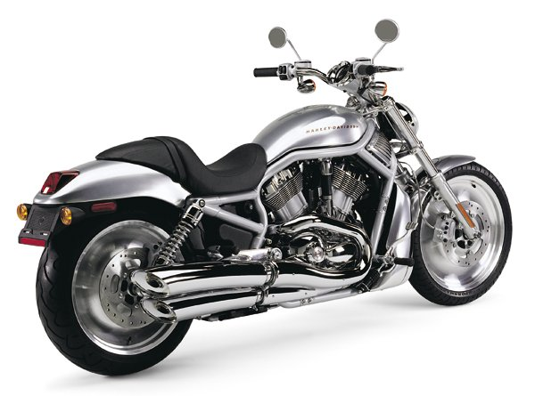
CREO PARAMETRIC – PART AND ASSEMBLY MODELING
Powerful, parametric design capabilities to create complex geometry and capture design intent
Who Needs It?
Customers that require the power and flexibility to model any geometry regardless of shape, size or complexity
Business Value
Reduce product costs
Reduce time-to-market
Reduce product development cost
Develop and define new markets
Process Improvement
3D part modeling
3D assembly modeling
Technology/ Capability
Create precise geometry, regardless of model complexity without compromise
Capture engineering requirements using feature parameters, constraints and relations
Easily create and manage complex assemblies using tools to manage and improve system performance
Perform global clearance and interference studies using static components and real-time collision detection (component drag)
Seamless integration with PTC Solutions to facilitate concurrent engineering

