Slide 1
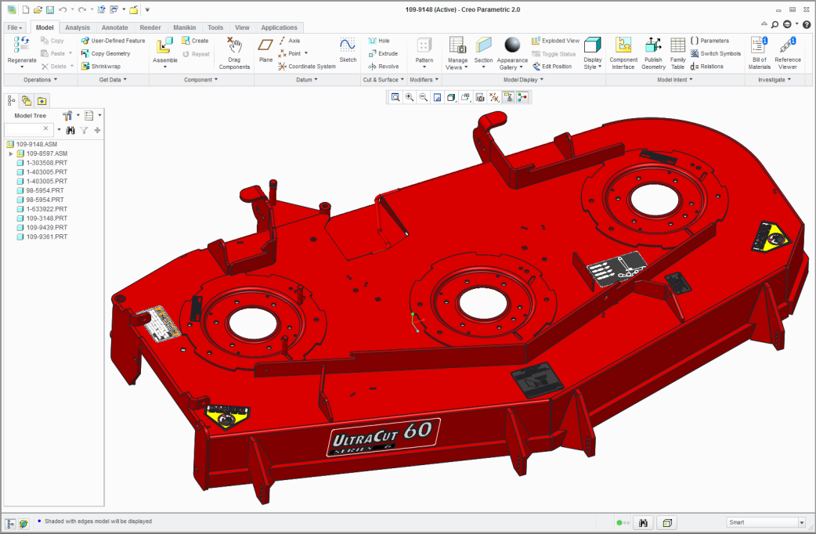
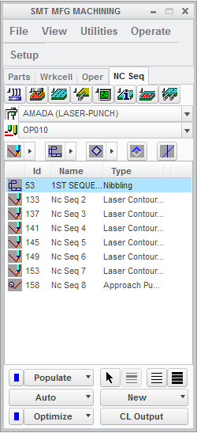
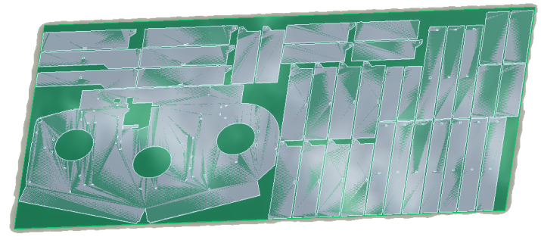
CREO NC SHEETMETAL EXTENSION
NC programming for turret punch presses, contouring laser/flame machines, nibbling and shearing
Who Needs It?
Any customer that creates and manufactures sheetmetal parts
Business Value
Reduce time-to-market
Reduce product development costs
Improve quality of manufactured products
Process Improvement
Integral CAD/CAM supporting concurrent design and manufacturing
NC Sheetmetal manufacturing
Part nesting and sheet optimization
Technology/ Capability
NC programming for turret punch presses, contouring laser/flame machines, nibbling and shearing
Automatic tool selection for punching, forming and nibbling
Automatic flat pattern development with bend allowances
Automatic change propagation and associative update of NC toolpaths
Full postprocessor generation capabilities to integrate with CNC machine tools
GPOST: NC Post-Processor generator

Slide 2
Creo Manufacturing Comparison Chart
 | Functionality | Prismatic & Multi-Surface Milling | Production Machining | Complete Machining | High Speed Milling | High Speed Milling Advanced | NC Sheetmetal
NC Machine type | 2 ½ Axis Feature Based Machining | ✔ | ✔ | ✔
 | 3 Axis Milling | ✔ | ✔ | ✔
 | 3 Axis High-speed Milling (HSM) Roughing, Rest Roughing, Finish and Rest Finish |  |  |  | ✔ | ✔
 | 5 Axis High-speed milling (HSM) Roughing, Rest Roughing, including automatic 3+2 Axis Roughing and Rest Roughing |  |  |  |  | ✔
 | 3to5 Axis High-speed Milling (HSM) Conversion for Finish and Rest Finish toolpaths |  |  |  |  | ✔
 | 5 Axis Auto Deburring |  |  |  |  | ✔
 | Basic Holemaking | ✔ | ✔ | ✔ | ✔ | ✔
 | Comprehensive Holemaking |  |  | ✔ |  | ✔
 | 3 Axis Trajectory | ✔ | ✔ | ✔ | ✔ | ✔
 | 2-4 Axis Turning |  | ✔ | ✔
 | 2-4 Axis Wire EDM |  | ✔ | ✔
 | Live Tooling for Turning (Mill/Turn) |  |  | ✔
 | 5 Axis Continuous Milling, including 5 Axis Trajectory |  |  | ✔
 | Multi-task Machining Synchronization |  |  | ✔
 | Dynamic Tool Axis Definition in Turning |  |  | ✔
Mfg. productivity tools | Extraction of Manufacturing Annotation Features | ✔ | ✔ | ✔ | ✔ | ✔
 | Tool and Fixture library | ✔ | ✔ | ✔ | ✔ | ✔
 | Manufacturing Process Documentation Pro/PROCESS for Manufacturing | ✔ | ✔ | ✔
 | Automatic Nesting |  |  |  |  |  | ✔
 | Punch Press and 2 Axis Laser Programming |  |  |  |  |  | ✔
Post & Sim. | Creo/NC-GPOST : NC Post-processor generator | ✔ | ✔ | ✔ | ✔ | ✔ | ✔
 | Moduleworks-based Material Removal | ✔ | ✔ | ✔ | ✔ | ✔

