Slide 1
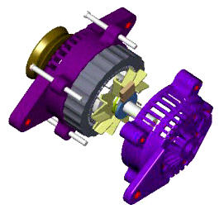
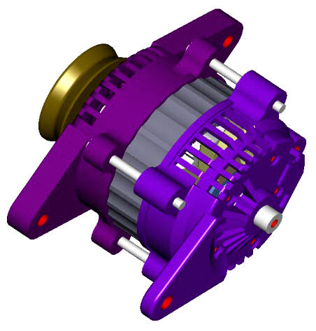
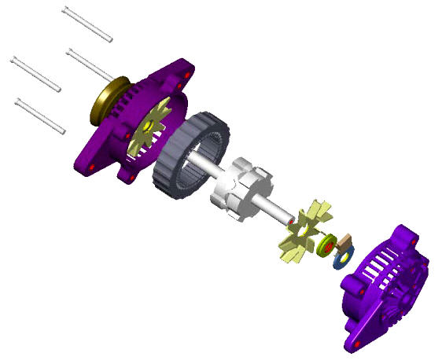
CREO PARAMETRIC – MODEL ANIMATION
Easily create assembly animations to demonstrate real-world behavior and assembly/disassembly instructions
Who Needs It?
Customers that create documentation and collateral to demonstrate functional and procedural product specifications and details
Business Value
Reduce product costs
Lower product lifecycle cost
Reduce product development cost
Develop and define new markets
Process Improvement
Design and functional product review
Work instructions and /Shop floor procedural documentation
Technology/ Capability
Easily define display states, orientations, and motion behavior using a graphical timeline to create and manage the animation
Define assembly and disassembly animations for shop floor service and repair
Reduce or eliminate the need to create lengthy documentation

