Slide 1
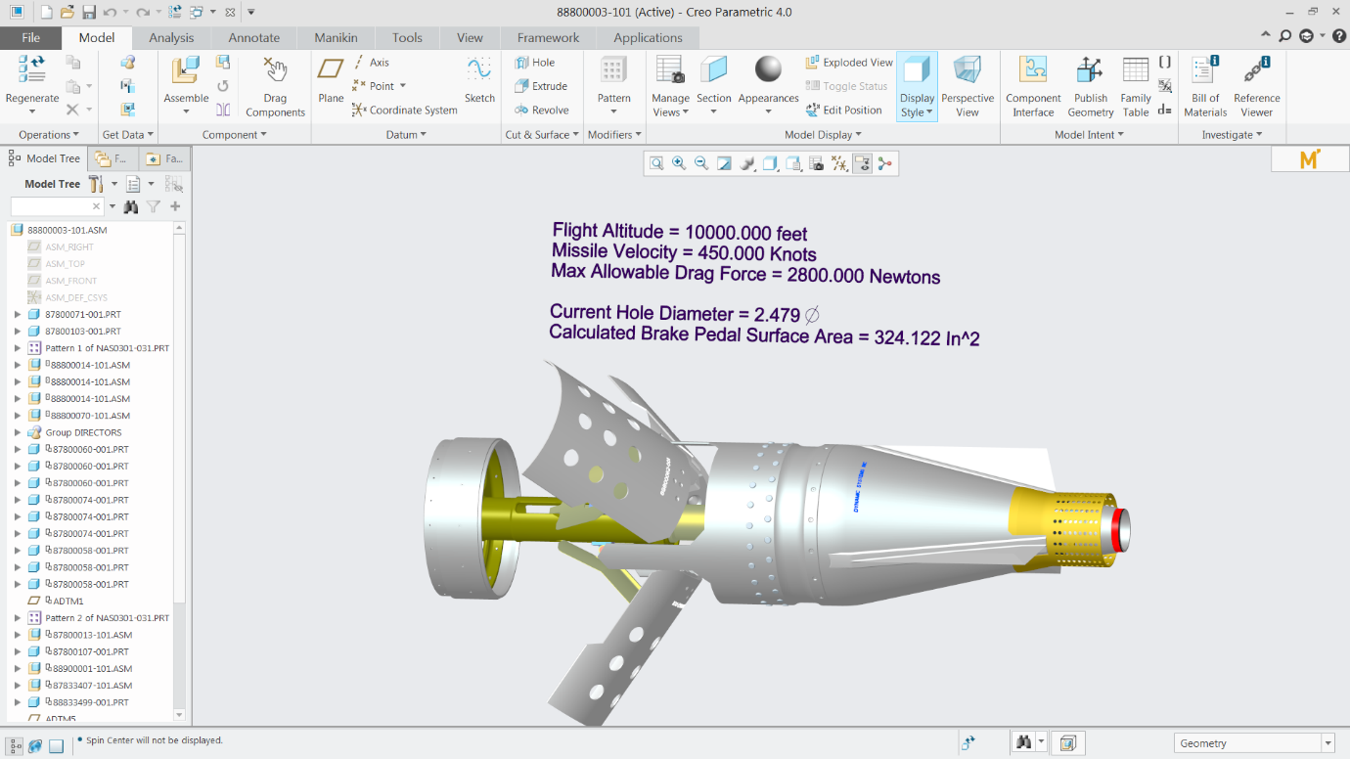
CREO PARAMETRIC – MATHCAD
Easily document and calculate design intent, criteria, assumptions and engineering critical values
Who Needs It?
Every customer that develops products using engineering calculations to define critical values for 3D part and assembly design
Engineering decisions and critical values must be defined and validated using mathematical calculations
Mathcad makes it easy to document, analyze and reuse provide engineering calculations
Embedded Mathcad Worksheet (icon)
Business Value
Reduce Time-To-Market
Reduce Product Development Costs
Improve Product Quality and Innovation
Improve global product development
Streamline regulatory compliance
Process Improvement
Rapidly document, analyze and share engineering calculation and critical values
Technology/ Capability
Calculate quickly
Analyze completely
Document thoroughly
Share and reuse effortlessly

Slide 2
Mathcad Capabilities (Full vs. Express)
 | FULL version | Express ( free for life)
Math Equation Editing | ✔ | ✔
Comprehensive Documentation | ✔ | ✔
Basic Numeric Functions and Operators | ✔ | ✔
Units | ✔ | ✔
X-Y Plots | ✔ | ✔
Global Définitions | ✔ | ✔
Template | ✔
Advanced Nyuméric Functions | ✔
Solving Systems of Equations | ✔
Programming | ✔
Symbolics | ✔
Excel Integration | ✔
Advance Plot Types | ✔
Custom Functions | ✔

