Slide 1
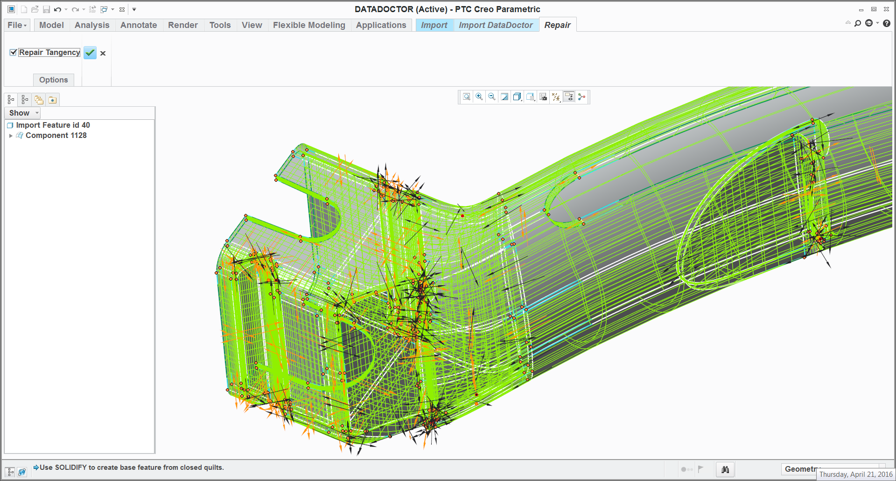
CREO PARAMETRIC − IMPORT DATA DOCTOR (IDD)
Automate the “repair” and “clean-up” of imported geometry
Who Needs It?
Customers that work with imported data and require the ability to repair translated geometry that has missing information, geometry gaps and errors
Data does not always translate 100%
Business Value
Reduce product costs
Reduce time-to-market
Reduce product development cost
Process Improvement
Repair and modification of imported data
Technology/ Capability
Tools to Repair, Modify and Featurize imported geometry
Repair tools – used to make geometry solid or improve the quality of imported surfaces and edges
Modification tools – used to move, replace, and manipulate imported geometry
Featurization tools – used to convert non-analytic geometry to analytic geometry and create curves and surfaces within the imported data

