Slide 1
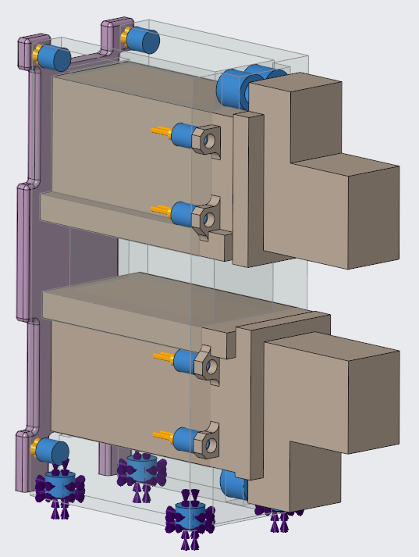
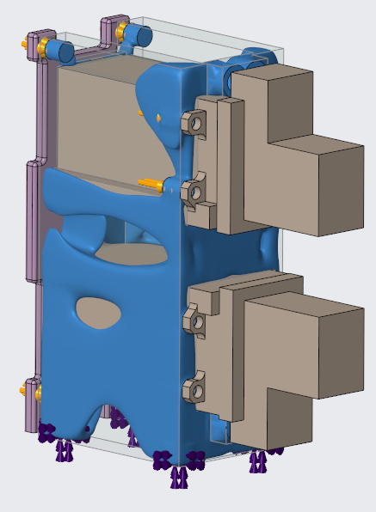
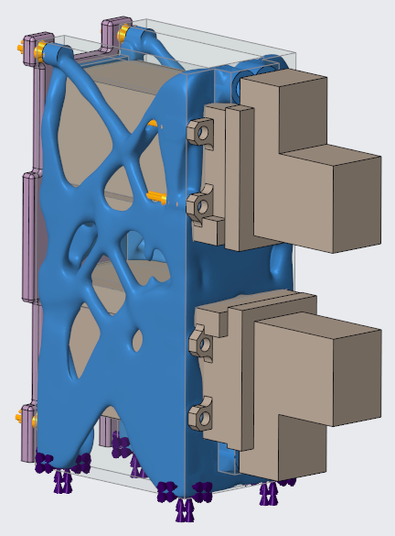
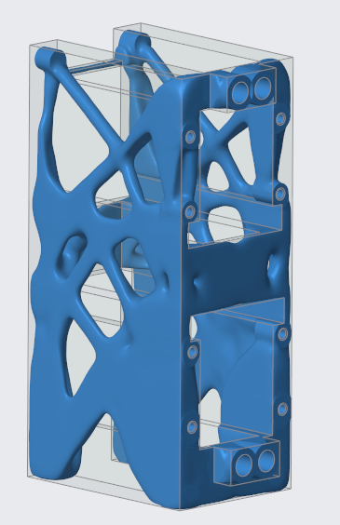
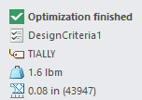
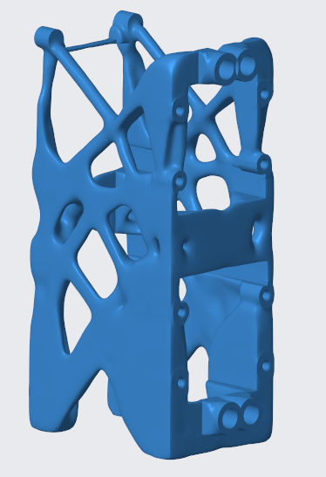
CREO GENERATIVE TOPOLOGY OPTIMIZATION (GTO)
Creo GTO automatically generates the optimal design solving for functional objectives, constraints, loads and manufacturing criteria
Who Needs It?
Every company that is focused on driving innovation and time to market
Business Value
AI driven Generative Topology Optimization (GTO) automatically creates the optimal design solving for design criteria, goals and objectives
Reduce Time-to-Market
Reduce Product Development Costs
Accelerate New Product Introduction
Improve Quality, Innovation and competitive differentiation
Process Improvement
Creo GTO transforms the way engineers design and develop products using generative design to create the optimal design solving for design criteria, goals and objectives
Technology/ Capability
Creo GTO delivers powerful optimization technology using a patented volumetric kernel and integrated Frustum FEA solvers
Powerful optimization engine uses AI driven design to automatically create manufacturable geometry

Slide 2
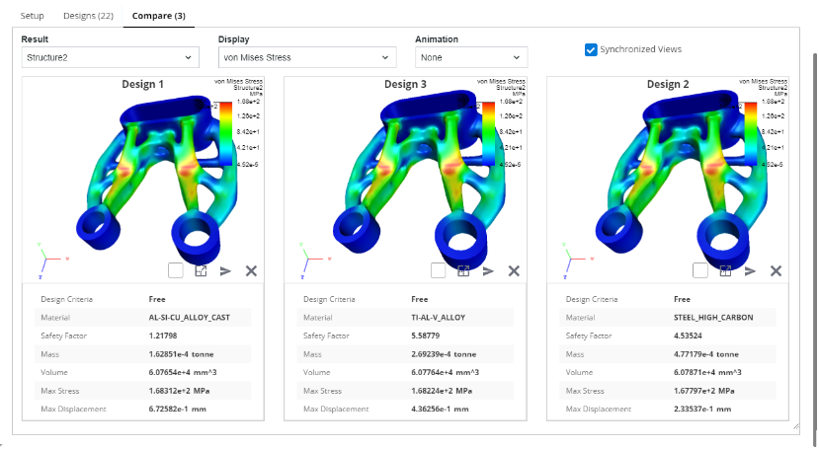
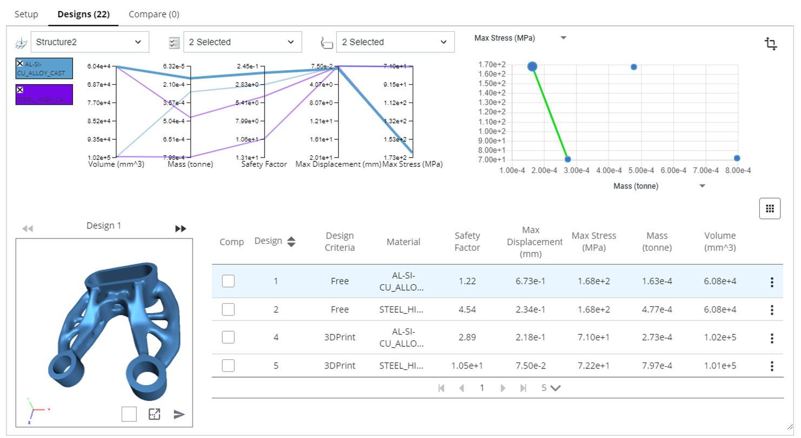
CREO GENERATIVE DESIGN EXTENSION (GDX)
Creo GDX provides high-performance cloud computing and advanced tools to compare, interrogate and select the optimal design
Who Needs It?
Every company that is focused on driving innovation and time to market
Business Value
Rapidly generate, evaluate and select the “best” design alternative using visual tools to interrogate and compare geometric and quantitative results
Reduce Time-to-Market
Reduce Product Development Costs
Accelerate New Product Introduction
Improve Quality, Innovation and competitive differentiation
Process Improvement
Transforms the way engineers conceptualize, explore, evaluate and design high-quality innovative products
Technology/ Capability
High-performance cloud computing simultaneously generates design solutions solving for a wide range of design criteria and objectives
Cloud computing eliminates lost time waiting for results to generate locally on the user's machine
Tools to filter, interrogate and compare the “range” of possible solutions
High confidence when selecting the “best” design to move forward to production

