Slide 1
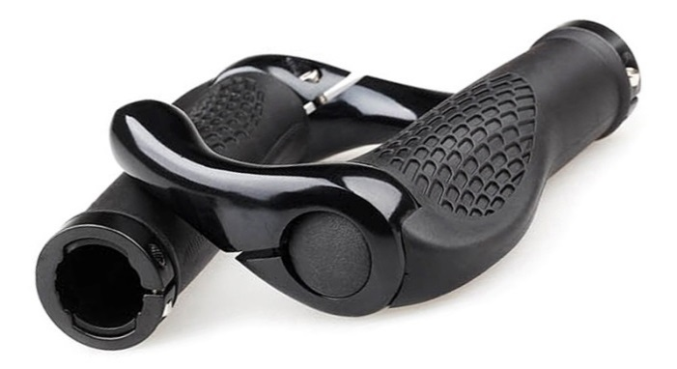
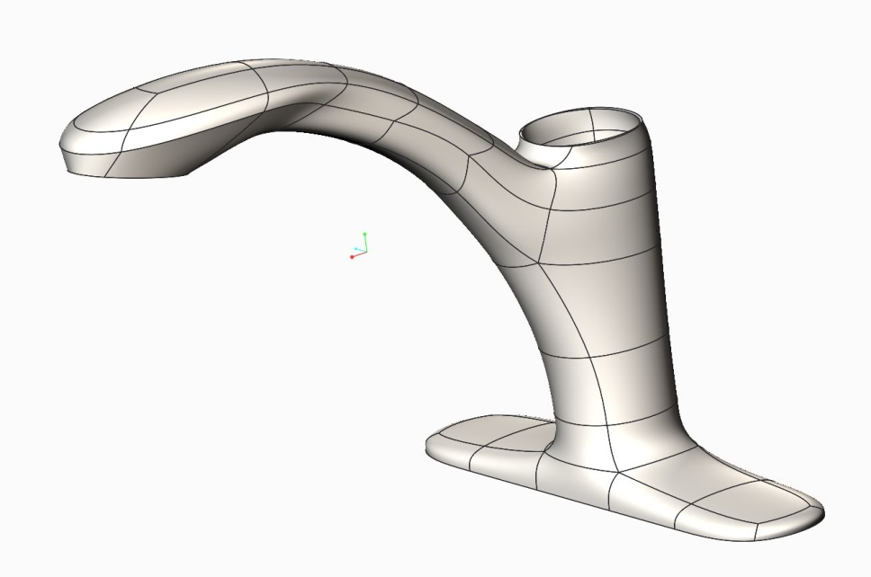
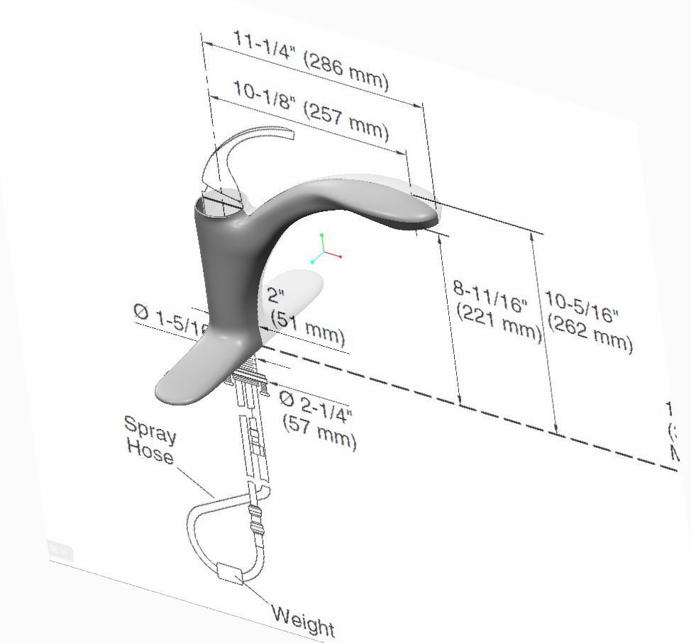
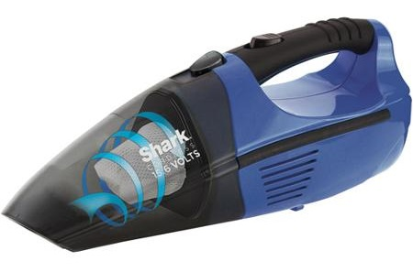
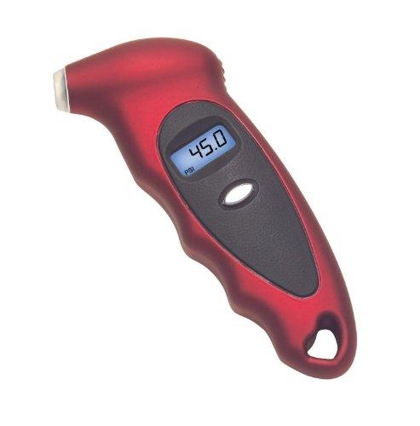
CREO FREESTYLE DESIGN
Rapidly create high-quality freeform surface geometry using primitive shape manipulation
Who Needs It?
Any customer that creates freeform surface geometry to satisfy aesthetic, ergonomic and functional design requirements
Business Value
Reduce time-to-market
Reduce product development cost
Improve product styling and competitive differentiation
Process Improvement
Conceptual design
Freeform and stylized surface creation
Technology/ Capability
Fast creation of high-quality surface geometry
Directly manipulate primitive shapes to create surface geometry
Enable novice users to create high-quality stylized surface geometry
No need to define curves and surfaces
No need to understand curve and patch structure
Ability to align Freestyle geometry to external entities
Notes:
Opportunity:
Creo Freestyle design will appeal to any customer that creates stylized and ergonomically designed products
Manufacturers of commodity type products (High Tech, Electronics, and Consumer Products) rely on styling to provide competitive differentiation
Medical devices and sports equipment are often ergonomically designed for comfort and function
Positioning:
Creo Freestyle design allows more designs to be created and evaluated during concept and detailed design
Freeform surface geometry is easily created by the surfacing novice
“Using PTC Creo Freestyle enables me to quickly and easily design ergonomic and aesthetic features and integrate them with existing geometry,”
says Dan Walker, studio engineer at BISSELL.

Slide 2
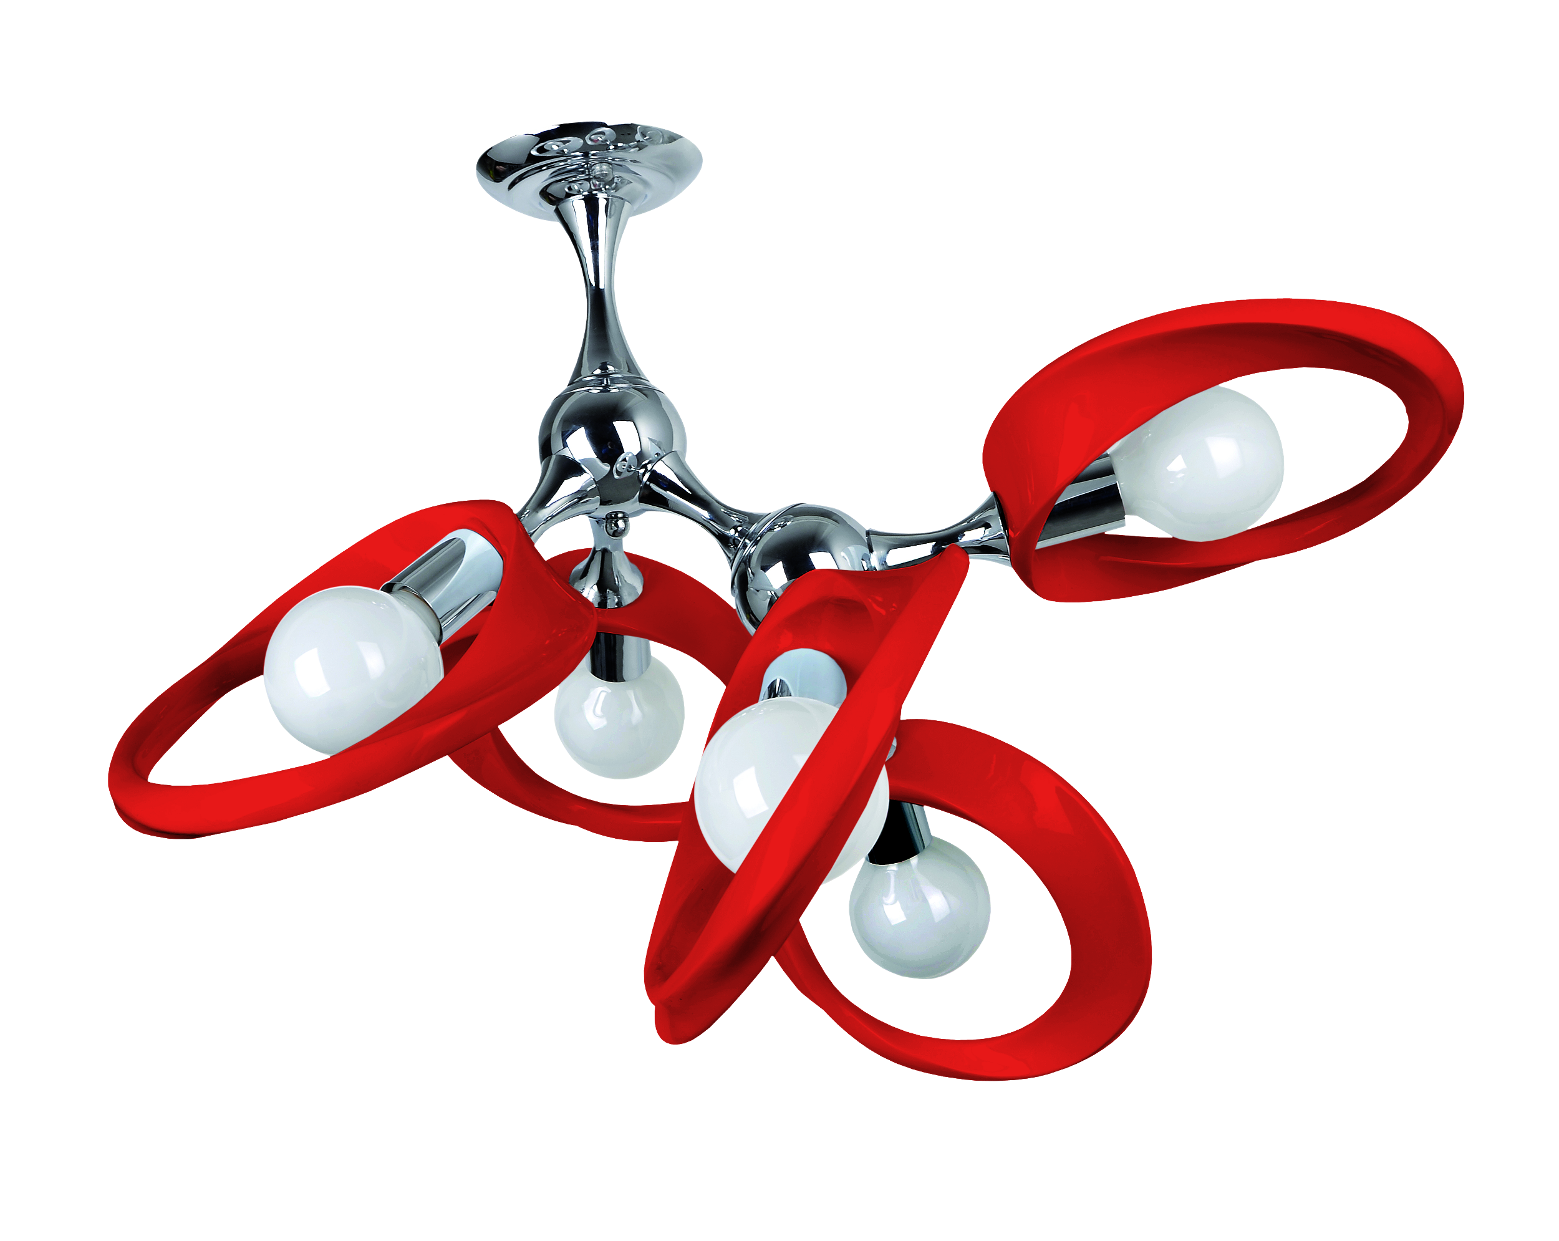
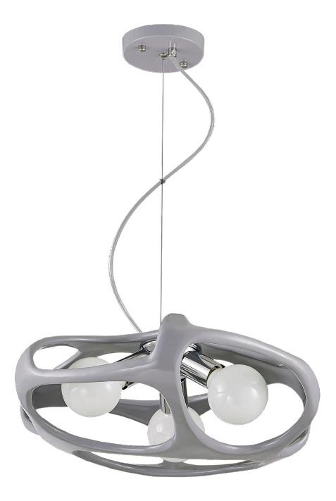
Freestyle Surfacing – why do we need it?
“
”Creo Parametric Freestyle Design, Flexible Modeling & Technical Surfacing capabilities have helped us in reducing concept to product development time by 35%.”
Mr. Kumaravel. P
GM
Lampex Electronics Limited

