Slide 1
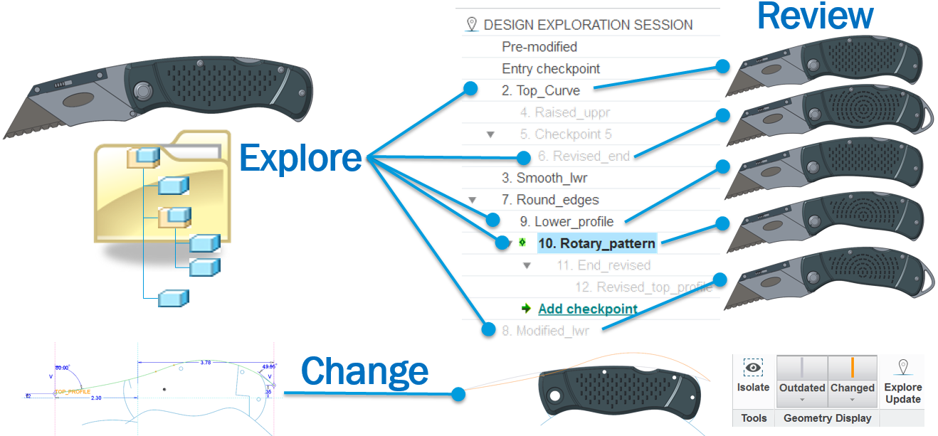
CREO DESIGN EXPLORATION EXTENSION (DEX)
Rapidly create and explore concepts and modeling alternatives
Who Needs It?
Every customer that strives to create and foster an environment that encourages design exploration, innovation and creativity
Business Value
Reduce time-to-market
Reduce product development cost
Improve product quality and innovation
Process Improvement
Design exploration
Design review and evaluation
Change investigation and exploration
Technology/ Capability
Rapidly explore and evaluate design ideas and modeling alternatives
Safely explore options and ideas using checkpoints to manage files and capture design history
Conduct interactive design reviews using saved DEX session data to review concepts and ideas
No need to clear in-session data, change folders and reload geometry
Easily investigate changes and implement change using “Explore Update” to eliminate risk

