Slide 1
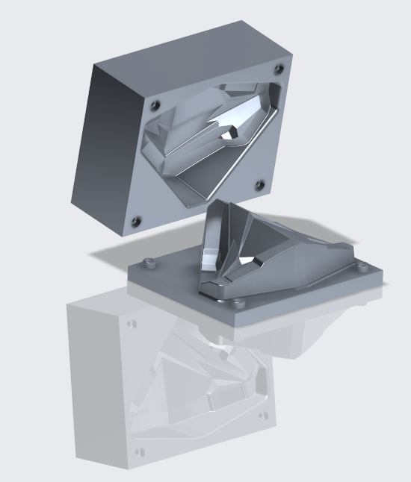
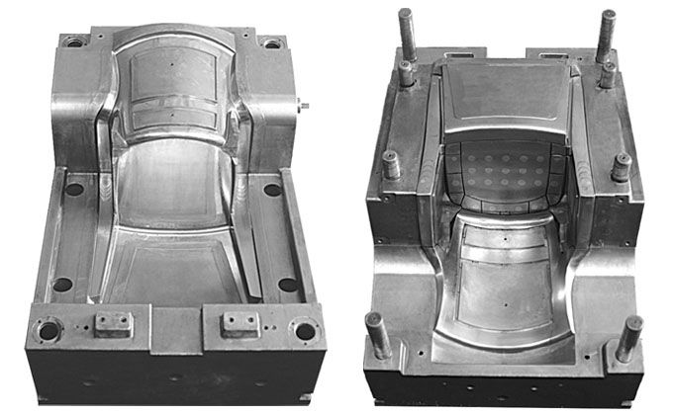
CREO TOOL DESIGN EXTENSION (TDO)
Accelerate the design of high-quality production mold and cast tooling
Who Needs It?
Any customer that creates manufacturing tooling for plastic injection molded parts and casted components
Contract manufacturing is highly competitive
Companies must deliver high quality products, on-time and under budget
Business Value
Reduce time-to-market
Reduce product development and manufacturing cost
Improve product quality and appearance
Process Improvement
Injection mold tooling design
Casting cavity and pattern design
Technology/ Capability
Easy to use process driven UI for Mold and Cast design
Automated creation of parting line and parting surface geometry
Associative design and tooling updates
Automated creation of production drawings and deliverables

