Slide 1
Creo Packaging and Solution Capabilities
July 2022
Note: With the planned release of Creo+, CAD packages and Extensions that contain "plus" will be renamed. This deck contains new naming conventions (see notes)
Notes:
To avoid confusion with the planned release of Creo+, CAD packages and Extensions that contain "plus" will be renamed.
Packages ("Professional")
Design Essentials, Design Advanced, Design Advanced Professional, Design Premium, Design Premium Professional​
Creo Parametric Essentials Professional, Creo Essentials Professional
Extensions ("Advanced")
Creo Simulation Live (CSL) Advanced​
Creo Flow Analysis (CFA) Advanced ​
Creo GD&T Advisor Advanced ​
Creo Additive Manufacturing (AMX) Advanced ​
Creo High Speed Milling Advanced
Go Live date for changes August 12, 2022

Slide 2
NEW CREO PACKAGES
T1
T2
T3
T4
T5
Creo Parametric
Collaboration Extensions for Inventor and SolidWorks
Simulation Elite (Linear Structural Analysis)
Flexible Modeling Extension
Design Exploration Extension
Piping and Cabling Extension
Render Studio Extension
Intelligent Fastener Extension
Advanced Framework Extension
Legacy Data Migration Extension
Human Factors Extension
Human Factors Analysis Extension
Mathcad Express
Advanced Assembly Extension
Prismatic and Multi-Surfaces Milling Extension
Mathcad
Additive Manufacturing Extension – Standard
Interactive Surface Design Extension II (ISDX II)
Behavioral Modeling Extension
Mechanism Dynamics Extension (MDO)
EZ Tolerance Analysis Extension (See Notes)
GD&T Advisor Extension
Tool Design Extension (TDO)
Expert Moldbase Extension (EMX)
High Speed Milling Advanced Extension (see Notes)
Layout Extension
Collaboration Extensions for CATIA V4 and V5
Collaboration Extension for NX
Simulation Extension
Fatigue Advisor Extension
Flow Analysis
GD&T Advisor Advanced
Production Machining Extension
NC Sheetmetal Extension
Advanced Simulation Extension
Complete Machining Extension
Flow Analysis Advanced
Options Modeler Extension
Creo Generative Topology Optimization (GTO) (See Notes)
Additive Manufacturing Advanced Extension
Package Highlights
Creo Design Essentials (T1)
Core functionality to design with confidence
Creo Design Advanced (T2)
Top-down design and concurrent engineering
Prismatic and multi-surface milling
Mathcad engineering calculations
Creo Design Advanced Professional (T3)
Advanced surfacing and additive manufacturing
Mechanism dynamics and behavioral modeling
GD&T Advisor and tolerance analysis
Mold design and mold machining
Creo Design Premium (T4)
Extended collaboration (CATIA V4/V5 & NX)
Simulation, flow analysis and fatigue advisor
Production machining
Creo Design Premium Professional (T5)
Advanced simulation and flow Analysis
Options modeler and topology optimization
Metal printing and complete machining
Note: In T4 and T5 packages, Creo Simulation Extension replaces Simulation “Elite”
Notes:
Creo Topology Optimization → Creo Generative Topology Optimization (GTO)
At the current time (Jan 2021), Top Optimization is in the T5 package which includes the GTO Serviceable. In Creo 7.0 or later you need to include the feature option for GTO (386) to your session of Creo to use the application. If the GTO license is a locked extension, you will need to add it to Creo through the installer. If the GTO license floating, you can simply launch Creo and click Applications > Generative Design to check-out the license.
The plan is to replace Top Op with Creo GTO in Creo 8.
Effective February 9, 2021 Mathcad has been added to the T2 and T3 seats. Prior to this time, Mathcad (Full) was only in the T4 and T5 packages.
Creo 8.0 (April 2021)
Creo High Speed Milling Advanced replaces Creo Mold Machining Extension
Same part #, adds additional HSM capabilities to support simultaneous 5-axis and 3+2-axis high speed machining
When customers install Creo 8.0 and later builds, the additional 5-axis HSM capabilities will be accessible
There is no need to update the license to get access
Creo High Speed Milling (New Offering)
Specialized capabilities to support 3-axis high speed machining
ISDX II History:
Many years ago (20+), PTC sold the Advanced Surface Extension (ASX) that included Pro/Surface, Pro/COMPOSITE and Pro/SCAN-TOOLS
Pro/SURFACE and Pro/SCAN-TOOLS were added to “core” Creo Parametric (Pro/SCAN-TOOLS was not included)
ISDX II – added ASX to the base ISDX to include Pro/SCAN-TOOLS
EZ Tolerance Analysis
EZ Tolerance Analysis replaces the Creo Tolerance Analysis Extension in Creo 7.0 and later builds
Released with Creo 7.0, back ported to Creo 4.0 M110 and later, Creo 5.060 and later, Creo 6.030 and later - option to install Creo TAE or EZ Tol for these builds

Slide 3
Creo Design Packages
All Creo Design Packages include “standard” Subscription Benefits
Standard eLearning
Home Use License
Support
Performance Advisor
Creo Design packages include eLearning access
Licenses provide Organization access to eLearning:
No direct license assignment required. Users simply use their PTC Services log on associated with their organization to gain access to eLearning.
License quantities are only used to monitor usage
Creo Design packages include Home Use License access
1 floating license = 2 Home Use 1 locked license = 1 Home Use
Home Use License provides Creo Design Essentials functionality
Functionality does not match what is purchased
Company admin must obtain locked license file for each user
Creo Design packages include PTC Gold Level Support
Major releases, security updates & maintenance
24x5 access to the Gold Support desk
Pro-active Support Alerts
Self-Guided Online Support and Intelligent Case Management
Creo Design packages include Performance Advisor (basic and advanced features)
Hardware and software performance monitoring
User and feature usage information
License Borrowing
Creo Design packages provide extended license borrowing
Extended to 180 days
Notes:
The subscription pricing model provides many benefits to our customers.
To speed user adoption and increase productivity, the complete Creo eLearning Libraries are now included with every Creo Essentials package. Home Use licenses are also provided with the purchase of every Creo Essentials License. For each floating license purchased, the customer receives 2 Home Use licenses, for each locked license purchased the customer receives 1 Home Use License. The Home Use license provides Creo Essentials functionality.
Subscription pricing eliminates the high upfront investment by combining software and maintenance at a greatly reduced rate equal to roughly 45% of the perpetual license cost. Gold Level Support provides major software releases, security updates and maintenance builds, 24X5 access to the gold support desk, pro-active support alerts, self-guided online support and intelligent case management.
Basic and premium performance advisor functionality is also included to provide hardware and software performance monitoring. License borrowing has also been extended to 180 days.
*****Home Use License*****
The following procedure details the steps that a customer would go through to obtain licenses and provide user access to Home Use software.
Admin creates list of users’ CPU_IDs that want a Home Use license
Admin uses the web tools to obtain locked license files for each user requesting Home Use License
Admin creates a thumb drive with a folder containing the codes and the Creo Installation software
Each user then takes the thumb drive home, installs the software, drags their specific license file into the licensing page of the installation and lets Creo install itself from there
See slide 24 for eLearning details

Slide 4
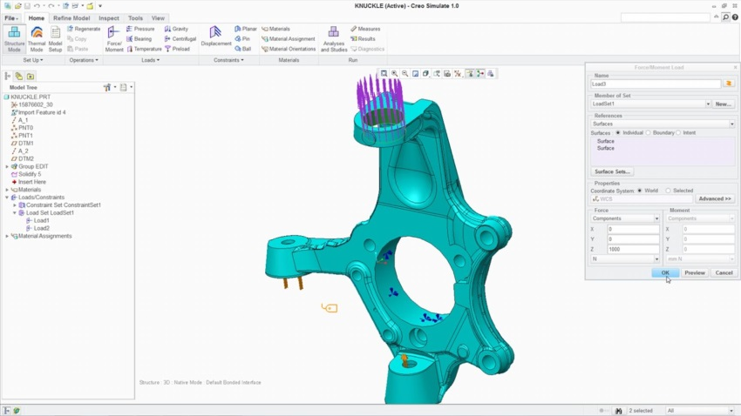
LINEAR STRUCTURAL ANALYSIS
Analyze and optimize the structural integrity of part and assembly models
Who Needs It?
The target customer must avoid product failures to mitigate risk of warranty, service, repair and liability
Business Value
Reduce time-to-market
Reduce product lifecycle cost
Reduce product development cost
Improve product quality and innovation
Process Improvement
Linear static structural analysis of parts and assemblies
Technology/ Capability
Seamless integration of design and analysis
Enable simulation-driven design to optimize product performance, quality and durability
Notes:
Opportunity:
The target prospect for Creo Simulate requires integral simulation capabilities to mitigate risk of warranty, service, repair and liability
If product failure can result in loss or endangerment of life, the company needs analysis to demonstrate safe operation and specify maximum load conditions
Positioning:
Creo Simulate delivers integral analysis capabilities to support early stage analysis and design optimization
Without analysis data to support engineering decisions companies risk law suites and legal liability

Slide 5
Creo Simulation Elite Capabilities
Creo Simulation Elite is included with Creo Design Essentials, Creo Design Advanced and Creo Design Advance Professional (T1,T2 and T3 packages)
Capability | Creo Simulation Elite
Simulation UI | ✔
Supported Analysis | Linear Static Analysis
Simulate Parts and Assemblies | ✔
Supported Load Types | Force/Moment, Pressure, Bearing, Temp, Gravity, Centrifugal
Supported Constraint Types | Displacement, Planar, Pin, Ball, Symmetry
Materials | Linear Isotropic (Only)
Supported Element Types | Beams, Simple Springs, Simple Mass, Simple shells, Shell Pairs (Basic Capabilities only)
Contact Interfaces | ✔ Adding infinite or finite friction interfaces requires full Simulate Extension
Welds, simple rigid links and basic fasteners | ✔
Surface and volume regions | ✔
A License Check system prompt will notify the user when unsupported functionality is selected or needed to open simulation models containing advanced simulation functionality and capabilities.

Slide 6
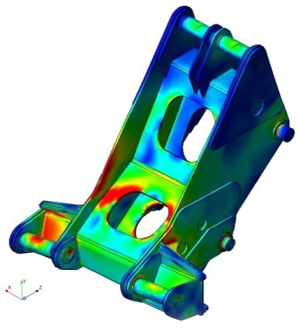
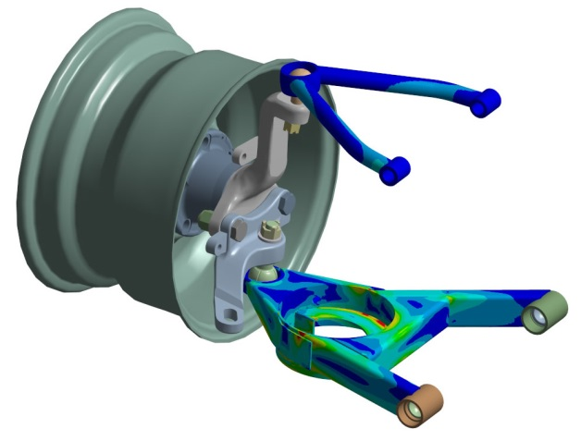
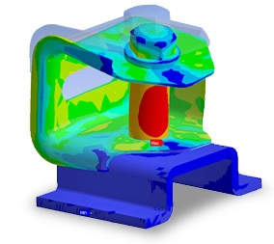
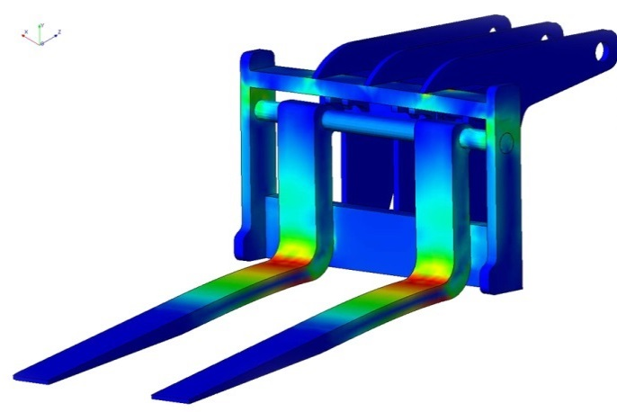
CREO SIMULATION EXTENSTION
Analyze and optimize the structural integrity of part and assembly models
Who Needs It?
The target customer must avoid product failures to mitigate risk of warranty, service, repair and liability
Business Value
Reduce time-to-market
Reduce product lifecycle cost
Reduce product development cost
Improve product quality and innovation
Process Improvement
Linear static structural analysis
Static structural analysis with small displacement
Modal structural analysis
Linear buckling structural analysis
Linear steady state thermal analysis
Technology/ Capability
Seamless integration of design and analysis
Enable simulation-driven design to optimize product performance, quality and durability
Notes:
Opportunity:
The target prospect for Creo Simulate requires integral simulation capabilities to mitigate risk of warranty, service, repair and liability
If product failure can result in loss or endangerment of life, the company needs analysis to demonstrate safe operation and specify maximum load conditions
Positioning:
Creo Simulate delivers integral analysis capabilities to support early stage analysis and design optimization
Without analysis data to support engineering decisions companies risk law suites and legal liability

Slide 7
Creo Simulation Product Overview
Capability | Creo Simulation Elite (linear static structural analysis) | PTC Creo Simulation Extension | PTC Creo Advanced Simulation Extension
Finite Element Analysis for Parts and Assemblies | ✔ | ✔ | ✔
Static Structural Analysis | ✔ | ✔ | ✔
Finite Element Modeling Idealization | ✔ | ✔ | ✔
Automatic Meshing | ✔ | ✔ | ✔
Results Display & Reporting | ✔ | ✔ | ✔
Modal & Buckling Analysis |  | ✔ | ✔
Steady State Thermal Analysis |  | ✔ | ✔
Design Optimization |  | ✔ | ✔
Contact Analysis |  | ✔ | ✔
Advanced Finite Element Idealization |  |  | ✔
Nonlinear Materials & Large Deformation |  |  | ✔
Dynamic & Pre-stress Analysis |  |  | ✔
Transient & Nonlinear Thermal Analysis |  |  | ✔
Note: Creo Parametric includes Simulation “lite” capabilities
Simplified wizard UI, basic loads and constraints, limitations on number of surfaces
Notes:
The functionality matrix was updated 3-1-19 to reference the Simulation Capabilities Brochure.
Lite Simulation capabilities are also included with Creo Parametric. The “lite” capabilities are presented using a simplified wizard UI. Users follow and step by step approach to define basic loads and constraints and run the analysis. Lite Simulate capabilities cannot be used to analyze models containing over 200 surfaces.
Creo Simulation “Elite” capabilities are included with the “old” Creo Essentials Premium – subscription bundle and the newly released Creo Design Essentials (T1), Creo Design Advanced (T2) and Creo Design Advanced Professional (T3) subscription packages. Note: Creo Design Premium (T4) and Creo Design Premium Professional (T5) include Creo Simulation Extension. Creo Simulation “Elite” provides a broader subset of Creo Simulate functionality allowing users to perform linear static analysis on parts and assemblies. Users are able to access the full Simulate UI to define analysis models using solids, beams, shells, masses and springs. There are no limitation on file size.
Additional details added 9-16-19 (Per Todd Kraft)
Precharge in idealized fasteners – Creo Simulation
Precharge in solid fasteners – Creo Advanced Simulation
Finite or infinite friction in contact regions
FINITE FRICTION= Creo Advanced Simulation
INFINITE FRICTION – Creo Simulation
Weighted links – Creo Advanced Simulation
Rigid links – Creo Simulation

Slide 8
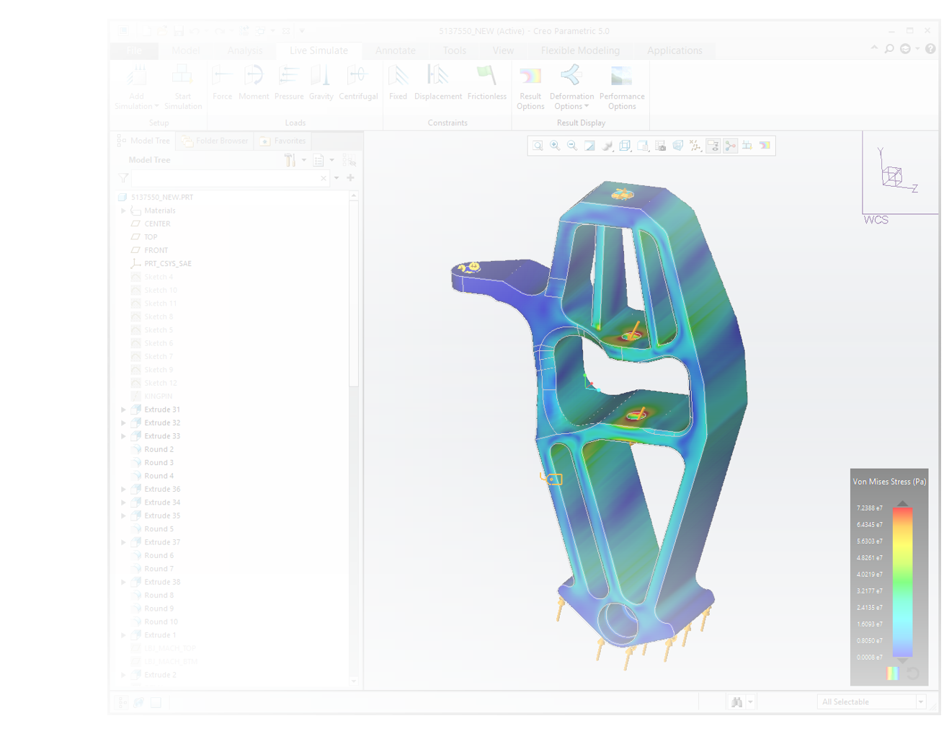
CREO SIMULATION LIVE EXTENSION
Creo Simulation Live puts fast and easy simulation into the hands of every engineer providing real time analysis feedback
Who Needs It?
Every design engineer that is focused on designing and developing high quality and high performance innovative products
Business Value
Use real time analysis data to support and guide design decisions and critical values
Streamline product development and speed time-to-market
Reduce product development cost (e.g., prototypes, rework, scrap)
Reduce design cycles and speed NPI
Reduce after-market service, warranty and repair cost
Increase market share via increased quality, brand loyalty and competitive differentiation
Process Improvement
Creo Simulation Live offers a new paradigm in 3D design exploration by putting real-time simulation in the hands of every engineer
Technology/ Capability
Creo Simulation Live is the integration of ANSYS Discovery technology into Creo, enabling near instantaneous static structural, thermal and modal simulation

Slide 9
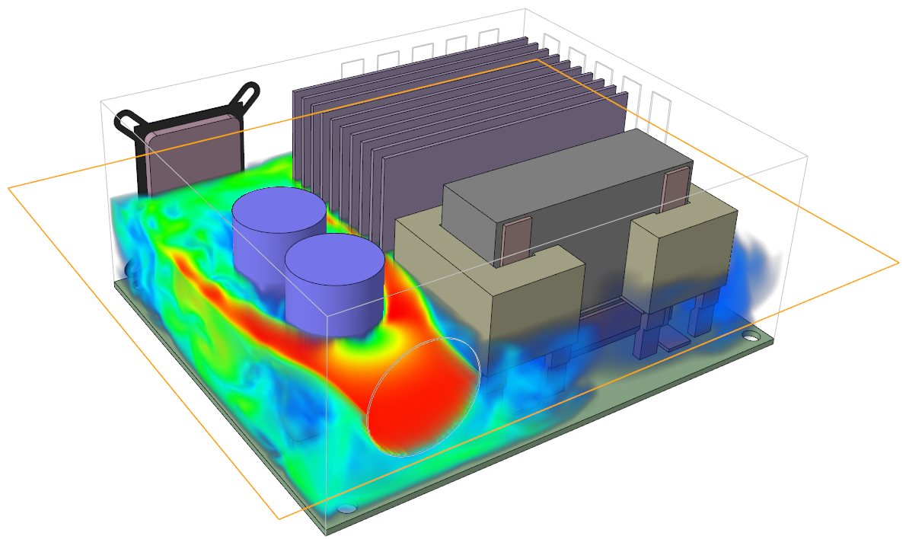
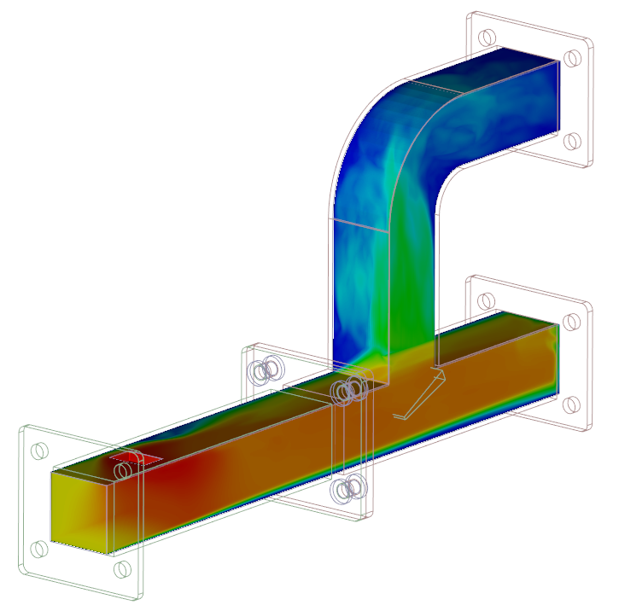
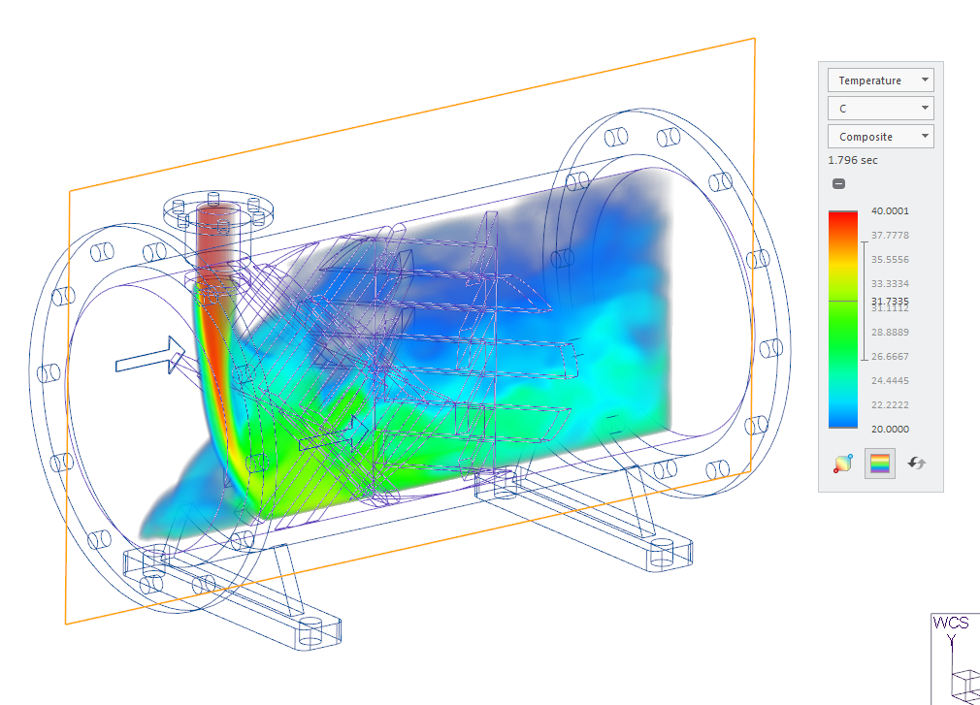
CREO SIMULATION LIVE ADVANCED EXTENSION
Creo Simulation Live Advanced puts fast and easy fluid flow simulation in the hands of every engineer providing real time analysis feedback
Who Needs It?
Every design engineer that is focused on designing and developing high quality and high-performance innovative products
Business Value
Use real time analysis data to support and guide design decisions and critical values
Streamline product development and speed time-to-market
Reduce product development cost (e.g., prototypes, rework, scrap)
Reduce design cycles and speed NPI
Reduce after-market service, warranty and repair cost
Increase market share via increased quality, brand loyalty and competitive differentiation
Process Improvement
Creo Simulation Live Advanced offers a new paradigm in 3D design exploration by putting real-time fluid flow simulation in the hands of every engineer
Technology/ Capability
Creo Simulation Live Advanced is the integration of ANSYS Discovery technology into Creo, enabling near instantaneous fluid flow simulation
Notes:
CSL Fluid Flow Highlights
Fluid Domain Creation
External Flow
Internal Flow
Results Display and Interactive Probes
Fluid Flow and Temperature Simulations
Streamlines, cut planes, particles and Direction Field

Slide 10
Creo Simulation Live Packages
Simulation Mo | Capability | Creo Simulation Live | Creo Simulation Live Advanced
Structural | Contraints: Fixed, Displacement, Frictionless, Cylindrical, Ball and Planar | ✔ | ✔
 | Loads: Force, Moment, Pressure, Gravity, Centrifugal, Linear, Acceleration | ✔ | ✔
Thermal | Contraints: Convection, Prescribed Temperature, Initial Temperature | ✔ | ✔
 | Steady State | ✔ | ✔
 | Transient | ✔ | ✔
 | Thermal Heat Loads: Heat Flow, Heat Flux | ✔ | ✔
Modal | Constraints: Fixed, Displacement | ✔ | ✔
 | Run on constrained or unconstrained | ✔ | ✔
Fluids | Fluid domain creation |  | ✔
 | External Flow: Transient simulation (with or without time limit) |  | ✔
 | Thermal conditions |  | ✔
 | Internal Flow: Flow velocities, inlet pressures, mass flow inputs |  | ✔
All Modes | Multi-body parts | ✔ | ✔
Results Display | Structure Results: Von Mises Stress, Deformation, Directional Normal and Shear Stress, Principal Stress, Reaction Forces | ✔ | ✔
 | Animation, Units Selection, Simulation Probe | ✔ | ✔
 | Mode shape selection (i.e., 1,2,…) | ✔ | ✔
 | Thermal Results: Temperature, Heat Flux and Transient Temperature graph | ✔ | ✔
 | Render Methods: Surface, Composite, Inverse Surface, Iso-Surface, Max/Min Value | ✔ | ✔
 | Fluids Results: Velocity, Temperature, Pressure, Time averaged display |  | ✔
 | Fluids Display: Streamlines for velocity results, Cut plane, Particles, Probes, Direction Fields |  | ✔
CSL Advanced includes the capabilities of CSL and Fluids

Slide 11
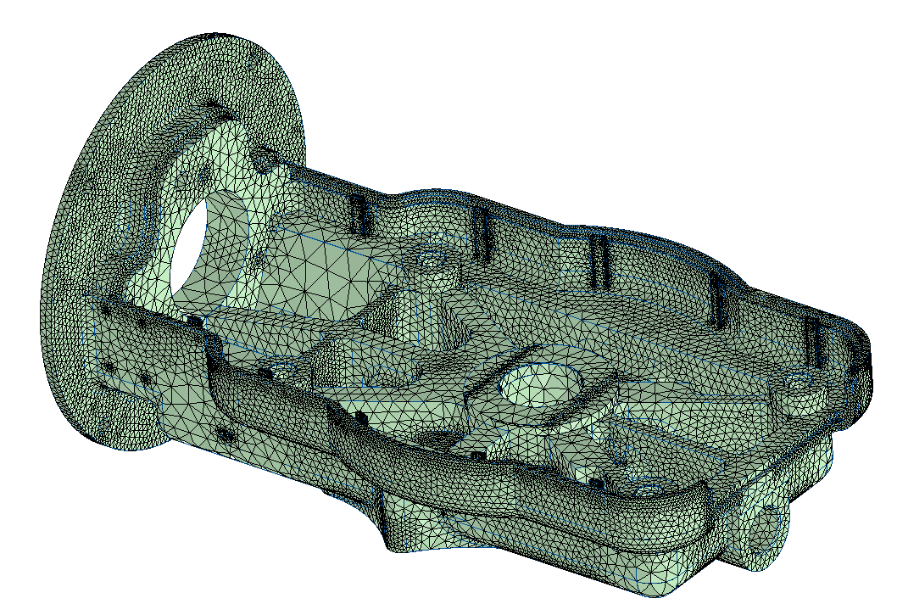
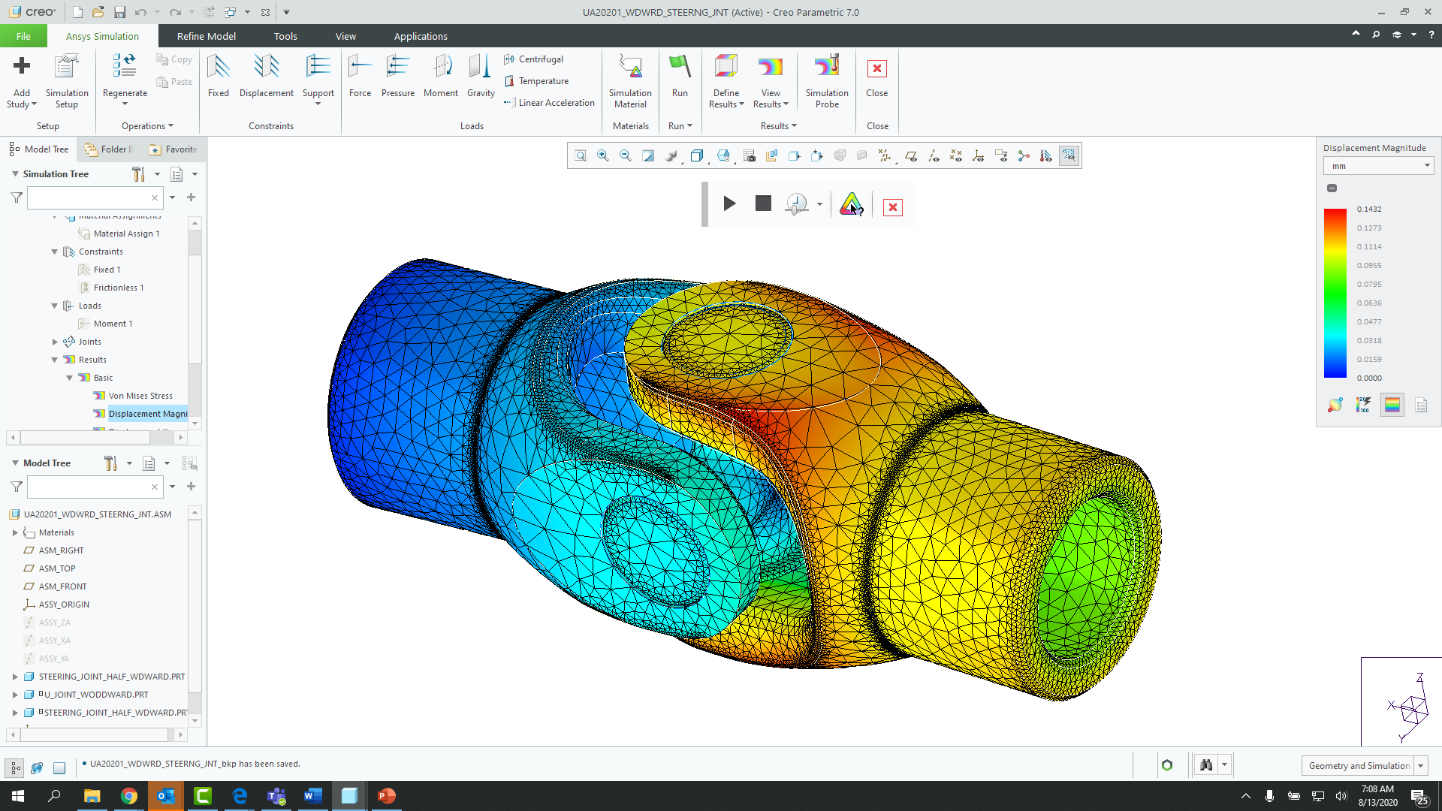
CREO ANSYS SIMULATION
Ansys Simulation puts best in class design and simulation capabilities at the fingertips of every designer and engineer
Who Needs It?
Customers that require high-fidelity simulation capabilities to support model refinement and validation using Ansys powered static structural, modal and thermal analysis
Business Value
Reduce time-to-market
Reduce product lifecycle cost
Reduce product development cost
Improve product quality and innovation
Process Improvement
Linear static structural, modal and thermal analysis of parts and assemblies
Technology/ Capability
Seamless integration of design and analysis
Fast simulation modeling and setup
Automated meshing and contact handling
High-fidelity results using Ansys powered solver and meshing technology running in Creo
Notes:
When refinement is near complete and designs are no longer subject to drastic or frequent change, more detailed “high-fidelity” analysis is performed using Ansys Simulation to generate highly accurate results
At this point, analysis may be turned over to specialist and experts that are more suited to perform “detailed” analysis
The setup information from Simulation Live can be directly used in Ansys Simulation eliminating any rework

Slide 12
Creo Simulation Product Overview
Capability | Creo Ansys Simulation | Creo Ansys Advanced (Future) Creo 9.0+ | PTC Creo Simulation Extension | PTC Creo Advanced Simulation Extension
Midsurface shell compression | ✔ (Creo 9.0) | ✔ (Creo 9.0) | ✔ | ✔
Joints | ✔ | ✔
Non-linear Contact |  | ✔ (Creo 10+) |  | ✔
Nonlinear Materials |  | ✔ (Creo 10+) |  | ✔
Advanced Finite Element Idealization | NA | NA |  | ✔
Pre-stress Static and Modal |  | ✔ (Creo 10+) |  | ✔
Fatigue |  | ✔ (Creo 10+)
Transient Structural |  | ✔ (Creo 10+) |  | ✔
Transient Thermal |  | ✔ (Creo 10+) |  | ✔
Random Vibration |  | ✔ (Creo 10+) |  | ✔
Basic Drop Test |  | ✔ (Planned)
Dynamic Analysis |  |  |  | ✔
Notes:
Note:
Positioning simulation capabilities can be difficult. Your best option is to share the capability matrix with your customer and have them select the solution that best fits their needs for simulation and analysis.

Slide 13
CREO FATIGUE ADVISOR EXTENSION
Analyze and optimize the structural integrity of part and assembly models
Who Needs It?
Customers that need to analyze the structural integrity of components subject to cyclical loading conditions and real world constraints
Business Value
Reduce time-to-market
Reduce product lifecycle cost
Reduce product development cost
Improve product quality and innovation
Process Improvement
Analyze and understand cycle fatigue and product durability
Accurately predict fatigue cycles and determine confidence of life
Calculate result quantities such as life, damage and factor of safety
Crack Initiation site
Technology/ Capability
Accurately models surface finish and treatment effects
Analyze the impact of repeated loading and unloading cycles
Predict how surface finish and treatment affect design durability
Determine the number of load cycles components can sustain before failure
Notes:
Question: Does Fatigue Advisor require Creo Simulation?
Fatigue Advisor Extension has the prerequisite PTC Creo Parametric, so it requires Creo Parametric but not Creo Simulation.
Applicability: Would you like to reduce product warranty costs by creating more durable products?
Tell me about the tools you use to predict the fatigue life of your products.
Explain the importance of being able to gain design confidence and improve product quality.
Describe the costs implications resulting from faulty or failed products.
To what extent do you perform fatigue analysis to avoid structural failures.
What percentage of structural failures are the result of fatigue failure.
What company initiatives or strategies are in place to reduce warranty and product liability costs.

Slide 14
CREO FLOW ANALYSIS EXTENSION
Analyze and optimize fluid and gas flow to improve product performance and function
Who Needs It?
Customers that need to analyze computational fluid dynamics (CFD) to understand and improve the functional performance and quality of products
Business Value
Reduce time-to-market
Reduce product lifecycle cost
Reduce product development cost
Improve product quality and innovation
Process Improvement
Analyze computational fluid dynamics (CFD) to improve product performance and function
CFD model preparation (one step creation of solid and fluid domains)
CFD model analysis (calculation speed and accuracy)
Technology/ Capability
Calculate internal and external flows
Animate flow results in real-time
Heat transfer analysis
Turbulence analysis
3 Packages to address customer need
− See next page for capability comparison
Creo Flow Analysis extension requires the installation of Creo 4.0 Maintenance release (M040) or later as well as the installation of Creo Advanced Assembly Ext.
The requirement to have AAX was resolved with Creo 4.0 M050.

Slide 15
Creo Flow Analysis – package Overview
Capability | Creo Flow Analysis | Creo Flow Analysis Advanced | Creo Flow Analysis Premium
Calculate Internal and External Flows | ✔ | ✔ | ✔
Animate Flow results in real-time | ✔ | ✔ | ✔
Parallel Processing Simulation | ✔ | ✔ | ✔
Simulate Flow | ✔ | ✔ | ✔
Heat Transfer | ✔ | ✔ | ✔
Turbulence | ✔ | ✔ | ✔
Particle |  | ✔ | ✔
Radiation |  | ✔ | ✔
Species |  | ✔ | ✔
Moving/Sliding Meshing |  | ✔ | ✔
Cavitation |  |  | ✔
Multiphase |  |  | ✔
Multicomponent |  |  | ✔
Dynamics |  |  | ✔
Analysis Types
Species Simulation - Simulate mixing of LIQUIDS with similar density
Multiphase - Used when simulating Gas and Liquid together
Multicomponent - Another mixing capability used for multiple Gases and density
Dynamics - Simulates FLUIDS and SOLIDS interaction
Cavitation - Simulates Vapor, Free Gas and Liquid (bubbles) compressibility
Notes:
Creo Flow Analysis is packaged to delivers three levels of functional capabilities at a competitive price point. Customer are able to choose the package that best meets their flow analysis requirements.
Creo Flow Analysis is competitively priced and functionally superior to SolidWorks and Inventor flow analysis offerings. When compared to Ansys Fluent and STAR CCM+, Creo Flow Analysis provides functionality and speed at a greatly reduced price point.

