Slide 1
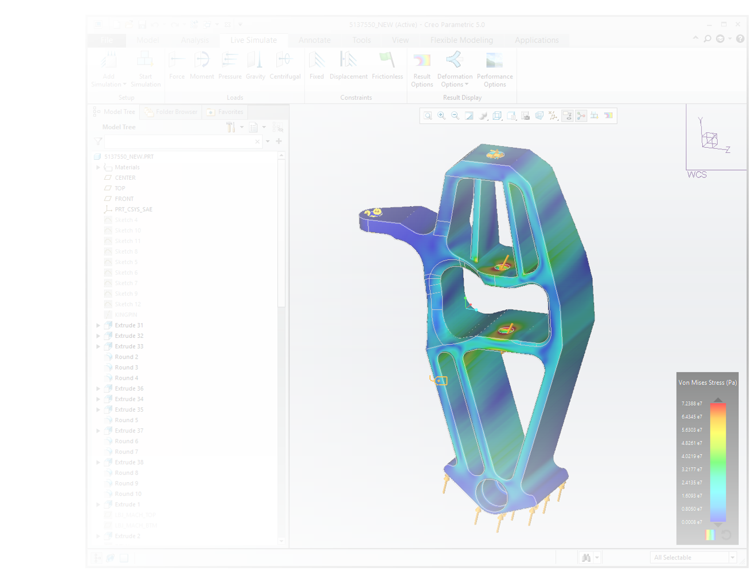
CREO SIMULATION LIVE EXTENSION
Creo Simulation Live puts fast and easy simulation into the hands of every engineer providing real time analysis feedback
Who Needs It?
Every design engineer that is focused on designing and developing high quality and high performance innovative products
Business Value
Use real time analysis data to support and guide design decisions and critical values
Streamline product development and speed time-to-market
Reduce product development cost (e.g., prototypes, rework, scrap)
Reduce design cycles and speed NPI
Reduce after-market service, warranty and repair cost
Increase market share via increased quality, brand loyalty and competitive differentiation
Process Improvement
Creo Simulation Live offers a new paradigm in 3D design exploration by putting real-time simulation in the hands of every engineer
Technology/ Capability
Creo Simulation Live is the integration of ANSYS Discovery technology into Creo, enabling near instantaneous static structural, thermal and modal simulation

Slide 2
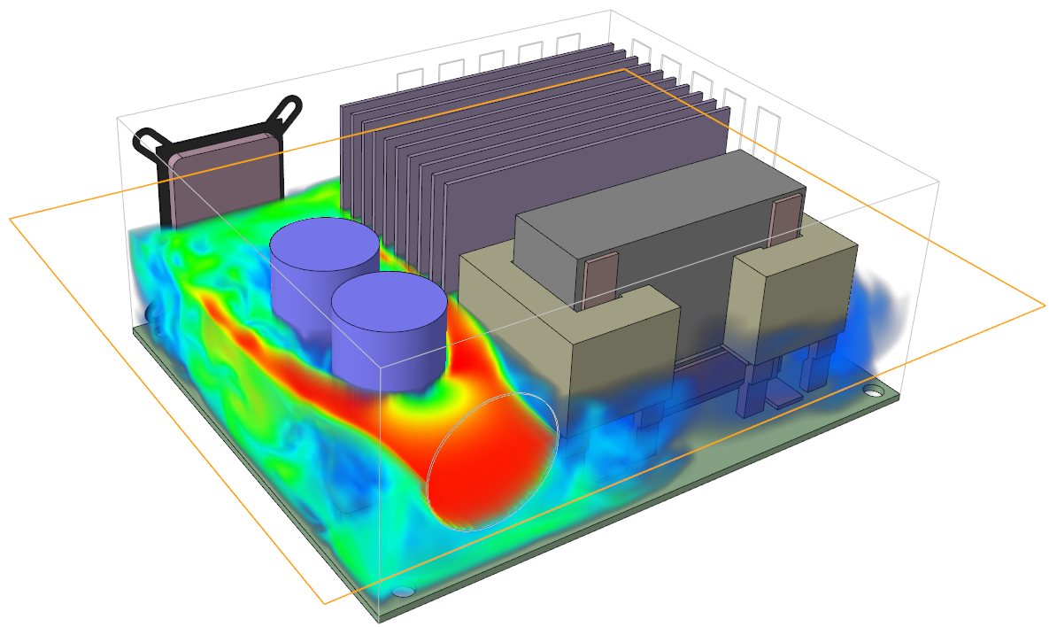
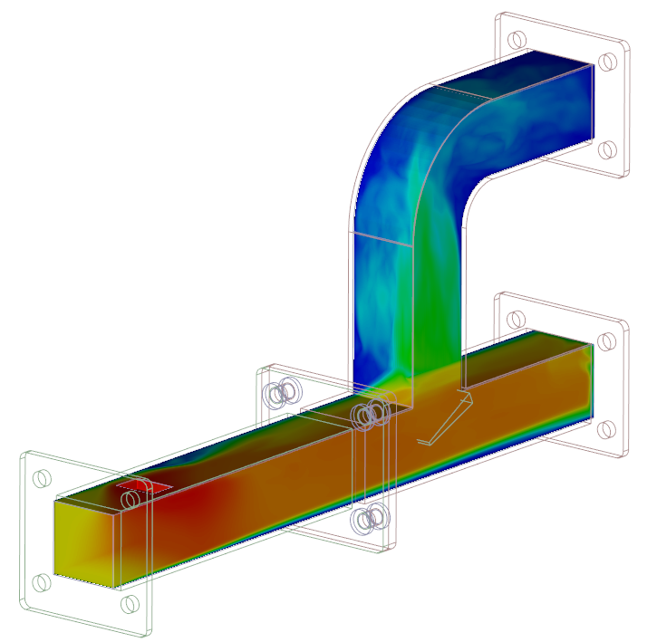
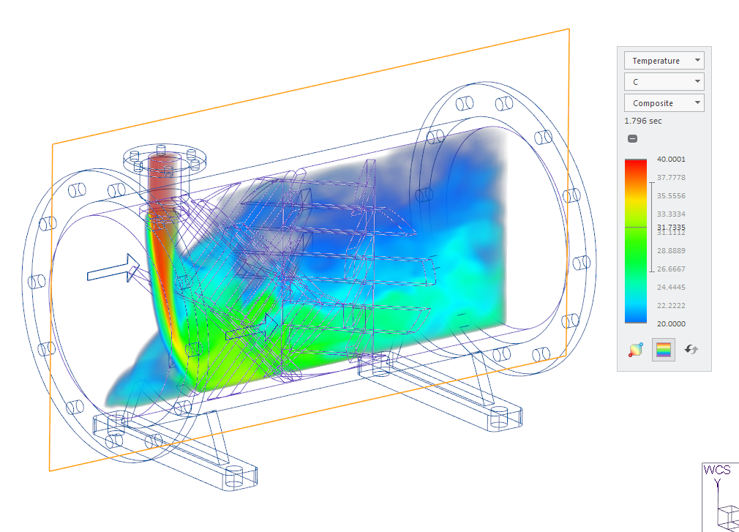
CREO SIMULATION LIVE ADVANCED EXTENSION
Creo Simulation Live Advanced puts fast and easy fluid flow simulation in the hands of every engineer providing real time analysis feedback
Who Needs It?
Every design engineer that is focused on designing and developing high quality and high-performance innovative products
Business Value
Use real time analysis data to support and guide design decisions and critical values
Streamline product development and speed time-to-market
Reduce product development cost (e.g., prototypes, rework, scrap)
Reduce design cycles and speed NPI
Reduce after-market service, warranty and repair cost
Increase market share via increased quality, brand loyalty and competitive differentiation
Process Improvement
Creo Simulation Live Advanced offers a new paradigm in 3D design exploration by putting real-time fluid flow simulation in the hands of every engineer
Technology/ Capability
Creo Simulation Live Advanced is the integration of ANSYS Discovery technology into Creo, enabling near instantaneous fluid flow simulation

Slide 3
Creo Simulation Live Packages
Simulation Mo | Capability | Creo Simulation Live | Creo Simulation Live Advanced
Structural | Contraints: Fixed, Displacement, Frictionless, Cylindrical, Ball and Planar | ✔ | ✔
 | Loads: Force, Moment, Pressure, Gravity, Centrifugal, Linear, Acceleration | ✔ | ✔
Thermal | Contraints: Convection, Prescribed Temperature, Initial Temperature | ✔ | ✔
 | Steady State | ✔ | ✔
 | Transient | ✔ | ✔
 | Thermal Heat Loads: Heat Flow, Heat Flux | ✔ | ✔
Modal | Constraints: Fixed, Displacement | ✔ | ✔
 | Run on constrained or unconstrained | ✔ | ✔
Fluids | Fluid domain creation |  | ✔
 | External Flow: Transient simulation (with or without time limit) |  | ✔
 | Thermal conditions |  | ✔
 | Internal Flow: Flow velocities, inlet pressures, mass flow inputs |  | ✔
All Modes | Multi-body parts | ✔ | ✔
Results Display | Structure Results: Von Mises Stress, Deformation, Directional Normal and Shear Stress, Principal Stress, Reaction Forces | ✔ | ✔
 | Animation, Units Selection, Simulation Probe | ✔ | ✔
 | Mode shape selection (i.e., 1,2,…) | ✔ | ✔
 | Thermal Results: Temperature, Heat Flux and Transient Temperature graph | ✔ | ✔
 | Render Methods: Surface, Composite, Inverse Surface, Iso-Surface, Max/Min Value | ✔ | ✔
 | Fluids Results: Velocity, Temperature, Pressure, Time averaged display |  | ✔
 | Fluids Display: Streamlines for velocity results, Cut plane, Particles, Probes, Direction Fields |  | ✔
CSL Advanced includes the capabilities of CSL and Fluids

Slide 4
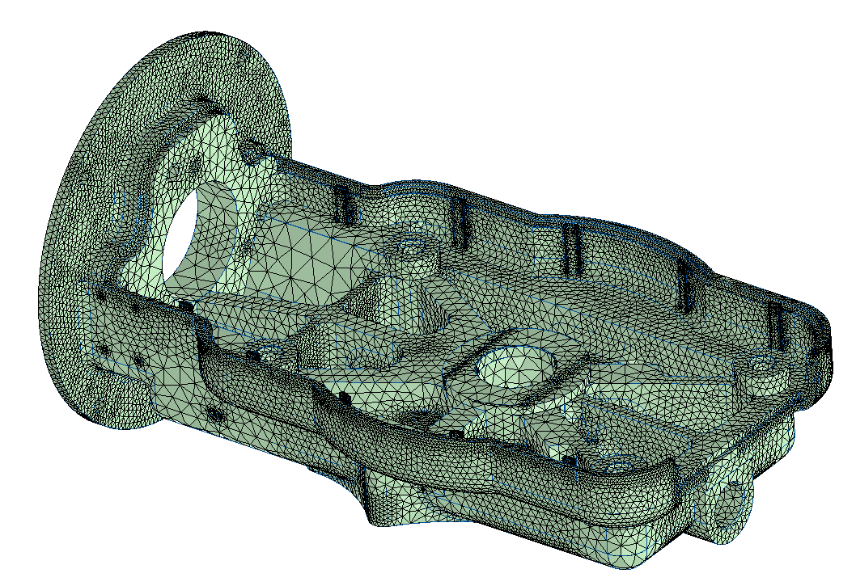
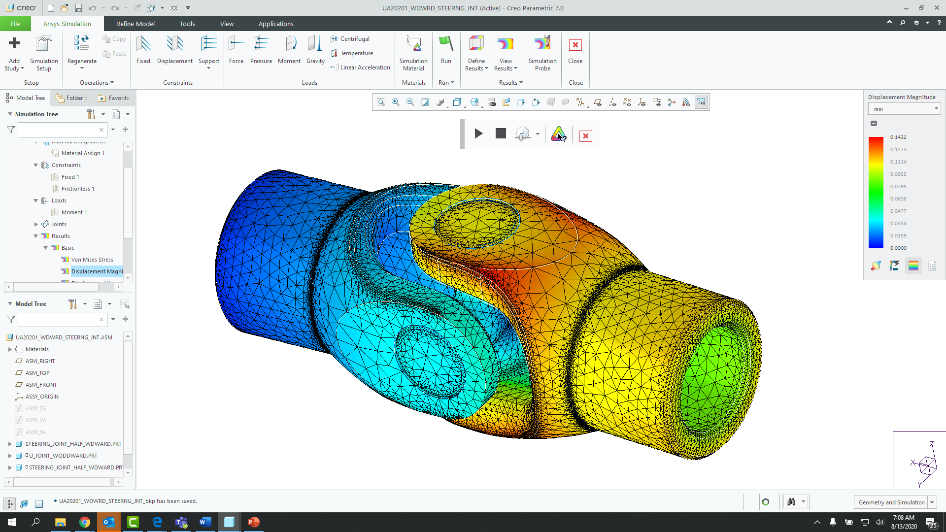
CREO ANSYS SIMULATION
Ansys Simulation puts best in class design and simulation capabilities at the fingertips of every designer and engineer
Who Needs It?
Customers that require high-fidelity simulation capabilities to support model refinement and validation using Ansys powered static structural, modal and thermal analysis
Business Value
Reduce time-to-market
Reduce product lifecycle cost
Reduce product development cost
Improve product quality and innovation
Process Improvement
Linear static structural, modal and thermal analysis of parts and assemblies
Technology/ Capability
Seamless integration of design and analysis
Fast simulation modeling and setup
Automated meshing and contact handling
High-fidelity results using Ansys powered solver and meshing technology running in Creo

Slide 5
Creo Simulation Product Overview
Capability | Creo Ansys Simulation | Creo Ansys Advanced (Future) Creo 9.0+ | PTC Creo Simulation Extension | PTC Creo Advanced Simulation Extension
Midsurface shell compression | ✔ (Creo 9.0) | ✔ (Creo 9.0) | ✔ | ✔
Joints | ✔ | ✔
Non-linear Contact |  | ✔ (Creo 10+) |  | ✔
Nonlinear Materials |  | ✔ (Creo 10+) |  | ✔
Advanced Finite Element Idealization | NA | NA |  | ✔
Pre-stress Static and Modal |  | ✔ (Creo 10+) |  | ✔
Fatigue |  | ✔ (Creo 10+)
Transient Structural |  | ✔ (Creo 10+) |  | ✔
Transient Thermal |  | ✔ (Creo 10+) |  | ✔
Random Vibration |  | ✔ (Creo 10+) |  | ✔
Basic Drop Test |  | ✔ (Planned)
Dynamic Analysis |  |  |  | ✔

Slide 6
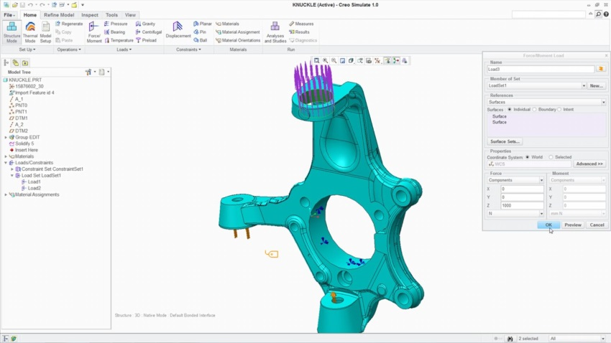
LINEAR STRUCTURAL ANALYSIS
Analyze and optimize the structural integrity of part and assembly models
Who Needs It?
The target customer must avoid product failures to mitigate risk of warranty, service, repair and liability
Business Value
Reduce time-to-market
Reduce product lifecycle cost
Reduce product development cost
Improve product quality and innovation
Process Improvement
Linear static structural analysis of parts and assemblies
Technology/ Capability
Seamless integration of design and analysis
Enable simulation-driven design to optimize product performance, quality and durability

Slide 7
Creo Simulation Elite Capabilities
Creo Simulation Elite is included with Creo Design Essentials, Creo Design Advanced and Creo Design Advance Professional (T1,T2 and T3 packages)
Capability | Creo Simulation Elite
Simulation UI | ✔
Supported Analysis | Linear Static Analysis
Simulate Parts and Assemblies | ✔
Supported Load Types | Force/Moment, Pressure, Bearing, Temp, Gravity, Centrifugal
Supported Constraint Types | Displacement, Planar, Pin, Ball, Symmetry
Materials | Linear Isotropic (Only)
Supported Element Types | Beams, Simple Springs, Simple Mass, Simple shells, Shell Pairs (Basic Capabilities only)
Contact Interfaces | ✔ Adding infinite or finite friction interfaces requires full Simulate Extension
Welds, simple rigid links and basic fasteners | ✔
Surface and volume regions | ✔
A License Check system prompt will notify the user when unsupported functionality is selected or needed to open simulation models containing advanced simulation functionality and capabilities.

Slide 8
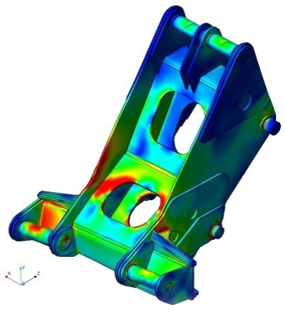
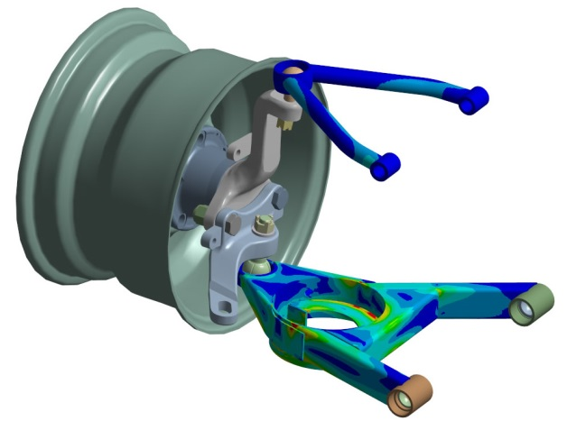
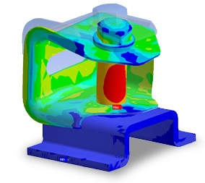
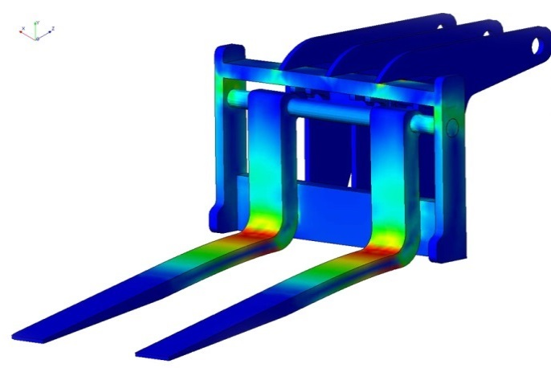
CREO SIMULATION EXTENSTION
Analyze and optimize the structural integrity of part and assembly models
Who Needs It?
The target customer must avoid product failures to mitigate risk of warranty, service, repair and liability
Business Value
Reduce time-to-market
Reduce product lifecycle cost
Reduce product development cost
Improve product quality and innovation
Process Improvement
Linear static structural analysis
Static structural analysis with small displacement
Modal structural analysis
Linear buckling structural analysis
Linear steady state thermal analysis
Technology/ Capability
Seamless integration of design and analysis
Enable simulation-driven design to optimize product performance, quality and durability

Slide 9
Creo Simulation Product Overview
Capability | Creo Simulation Elite (linear static structural analysis) | PTC Creo Simulation Extension | PTC Creo Advanced Simulation Extension
Finite Element Analysis for Parts and Assemblies | ✔ | ✔ | ✔
Static Structural Analysis | ✔ | ✔ | ✔
Finite Element Modeling Idealization | ✔ | ✔ | ✔
Automatic Meshing | ✔ | ✔ | ✔
Results Display & Reporting | ✔ | ✔ | ✔
Modal & Buckling Analysis |  | ✔ | ✔
Steady State Thermal Analysis |  | ✔ | ✔
Design Optimization |  | ✔ | ✔
Contact Analysis |  | ✔ | ✔
Advanced Finite Element Idealization |  |  | ✔
Nonlinear Materials & Large Deformation |  |  | ✔
Dynamic & Pre-stress Analysis |  |  | ✔
Transient & Nonlinear Thermal Analysis |  |  | ✔
Note: Creo Parametric includes Simulation “lite” capabilities
Simplified wizard UI, basic loads and constraints, limitations on number of surfaces

Slide 10
CREO FATIGUE ADVISOR EXTENSION
Analyze and optimize the structural integrity of part and assembly models
Who Needs It?
Customers that need to analyze the structural integrity of components subject to cyclical loading conditions and real world constraints
Business Value
Reduce time-to-market
Reduce product lifecycle cost
Reduce product development cost
Improve product quality and innovation
Process Improvement
Analyze and understand cycle fatigue and product durability
Accurately predict fatigue cycles and determine confidence of life
Calculate result quantities such as life, damage and factor of safety
Crack Initiation site
Technology/ Capability
Accurately models surface finish and treatment effects
Analyze the impact of repeated loading and unloading cycles
Predict how surface finish and treatment affect design durability
Determine the number of load cycles components can sustain before failure

Slide 11
CREO FLOW ANALYSIS EXTENSION
Analyze and optimize fluid and gas flow to improve product performance and function
Who Needs It?
Customers that need to analyze computational fluid dynamics (CFD) to understand and improve the functional performance and quality of products
Business Value
Reduce time-to-market
Reduce product lifecycle cost
Reduce product development cost
Improve product quality and innovation
Process Improvement
Analyze computational fluid dynamics (CFD) to improve product performance and function
CFD model preparation (one step creation of solid and fluid domains)
CFD model analysis (calculation speed and accuracy)
Technology/ Capability
Calculate internal and external flows
Animate flow results in real-time
Heat transfer analysis
Turbulence analysis
3 Packages to address customer need
− See next page for capability comparison
Creo Flow Analysis extension requires the installation of Creo 4.0 Maintenance release (M040) or later as well as the installation of Creo Advanced Assembly Ext.
The requirement to have AAX was resolved with Creo 4.0 M050.

Slide 12
Creo Flow Analysis – package Overview
Capability | Creo Flow Analysis | Creo Flow Analysis Advanced | Creo Flow Analysis Premium
Calculate Internal and External Flows | ✔ | ✔ | ✔
Animate Flow results in real-time | ✔ | ✔ | ✔
Parallel Processing Simulation | ✔ | ✔ | ✔
Simulate Flow | ✔ | ✔ | ✔
Heat Transfer | ✔ | ✔ | ✔
Turbulence | ✔ | ✔ | ✔
Particle |  | ✔ | ✔
Radiation |  | ✔ | ✔
Species |  | ✔ | ✔
Moving/Sliding Meshing |  | ✔ | ✔
Cavitation |  |  | ✔
Multiphase |  |  | ✔
Multicomponent |  |  | ✔
Dynamics |  |  | ✔
Analysis Types
Species Simulation - Simulate mixing of LIQUIDS with similar density
Multiphase - Used when simulating Gas and Liquid together
Multicomponent - Another mixing capability used for multiple Gases and density
Dynamics - Simulates FLUIDS and SOLIDS interaction
Cavitation - Simulates Vapor, Free Gas and Liquid (bubbles) compressibility

