Slide 1
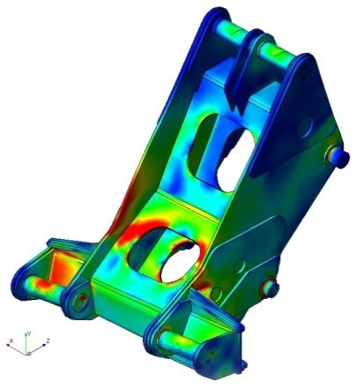
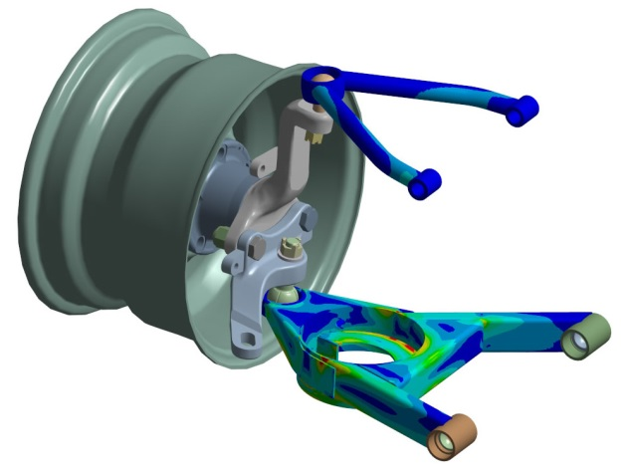
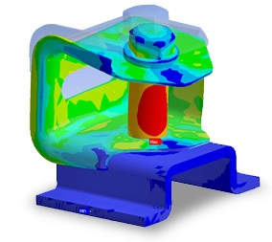
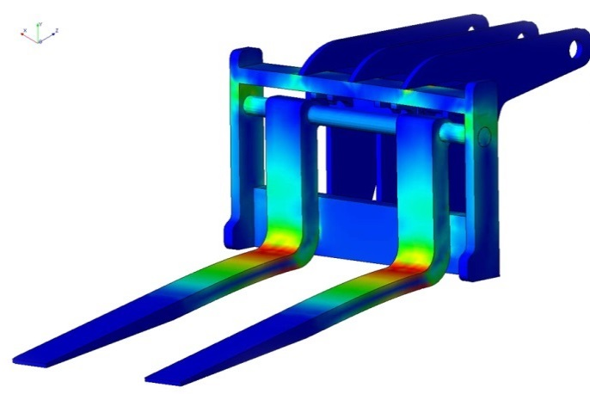
CREO SIMULATION EXTENSTION
Analyze and optimize the structural integrity of part and assembly models
Who Needs It?
The target customer must avoid product failures to mitigate risk of warranty, service, repair and liability
Business Value
Reduce time-to-market
Reduce product lifecycle cost
Reduce product development cost
Improve product quality and innovation
Process Improvement
Linear static structural analysis
Static structural analysis with small displacement
Modal structural analysis
Linear buckling structural analysis
Linear steady state thermal analysis
Technology/ Capability
Seamless integration of design and analysis
Enable simulation-driven design to optimize product performance, quality and durability

Slide 2
Creo Simulation Product Overview
Capability | Creo Simulation Elite (linear static structural analysis) | PTC Creo Simulation Extension | PTC Creo Advanced Simulation Extension
Finite Element Analysis for Parts and Assemblies | ✔ | ✔ | ✔
Static Structural Analysis | ✔ | ✔ | ✔
Finite Element Modeling Idealization | ✔ | ✔ | ✔
Automatic Meshing | ✔ | ✔ | ✔
Results Display & Reporting | ✔ | ✔ | ✔
Modal & Buckling Analysis |  | ✔ | ✔
Steady State Thermal Analysis |  | ✔ | ✔
Design Optimization |  | ✔ | ✔
Contact Analysis |  | ✔ | ✔
Advanced Finite Element Idealization |  |  | ✔
Nonlinear Materials & Large Deformation |  |  | ✔
Dynamic & Pre-stress Analysis |  |  | ✔
Transient & Nonlinear Thermal Analysis |  |  | ✔
Note: Creo Parametric includes Simulation “lite” capabilities
Simplified wizard UI, basic loads and constraints, limitations on number of surfaces

