Slide 1
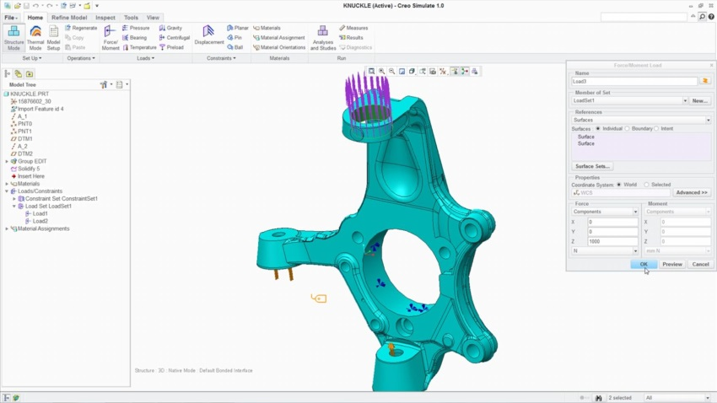
LINEAR STRUCTURAL ANALYSIS
Analyze and optimize the structural integrity of part and assembly models
Who Needs It?
The target customer must avoid product failures to mitigate risk of warranty, service, repair and liability
Business Value
Reduce time-to-market
Reduce product lifecycle cost
Reduce product development cost
Improve product quality and innovation
Process Improvement
Linear static structural analysis of parts and assemblies
Technology/ Capability
Seamless integration of design and analysis
Enable simulation-driven design to optimize product performance, quality and durability
Notes:
Opportunity:
The target prospect for Creo Simulate requires integral simulation capabilities to mitigate risk of warranty, service, repair and liability
If product failure can result in loss or endangerment of life, the company needs analysis to demonstrate safe operation and specify maximum load conditions
Positioning:
Creo Simulate delivers integral analysis capabilities to support early stage analysis and design optimization
Without analysis data to support engineering decisions companies risk law suites and legal liability

Slide 2
Creo Simulation Elite Capabilities
Creo Simulation Elite is included with Creo Design Essentials, Creo Design Advanced and Creo Design Advance Professional (T1,T2 and T3 packages)
Capability | Creo Simulation Elite
Simulation UI | ✔
Supported Analysis | Linear Static Analysis
Simulate Parts and Assemblies | ✔
Supported Load Types | Force/Moment, Pressure, Bearing, Temp, Gravity, Centrifugal
Supported Constraint Types | Displacement, Planar, Pin, Ball, Symmetry
Materials | Linear Isotropic (Only)
Supported Element Types | Beams, Simple Springs, Simple Mass, Simple shells, Shell Pairs (Basic Capabilities only)
Contact Interfaces | ✔ Adding infinite or finite friction interfaces requires full Simulate Extension
Welds, simple rigid links and basic fasteners | ✔
Surface and volume regions | ✔
A License Check system prompt will notify the user when unsupported functionality is selected or needed to open simulation models containing advanced simulation functionality and capabilities.

Slide 3
Creo Simulation Product Overview
Capability | Creo Simulation Elite (linear static structural analysis) | PTC Creo Simulation Extension | PTC Creo Advanced Simulation Extension
Finite Element Analysis for Parts and Assemblies | ✔ | ✔ | ✔
Static Structural Analysis | ✔ | ✔ | ✔
Finite Element Modeling Idealization | ✔ | ✔ | ✔
Automatic Meshing | ✔ | ✔ | ✔
Results Display & Reporting | ✔ | ✔ | ✔
Modal & Buckling Analysis |  | ✔ | ✔
Steady State Thermal Analysis |  | ✔ | ✔
Design Optimization |  | ✔ | ✔
Contact Analysis |  | ✔ | ✔
Advanced Finite Element Idealization |  |  | ✔
Nonlinear Materials & Large Deformation |  |  | ✔
Dynamic & Pre-stress Analysis |  |  | ✔
Transient & Nonlinear Thermal Analysis |  |  | ✔
Note: Creo Parametric includes Simulation “lite” capabilities
Simplified wizard UI, basic loads and constraints, limitations on number of surfaces

