Slide 1
Creo Sheet metal Design

Slide 2
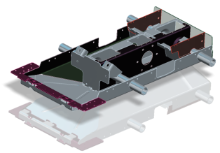
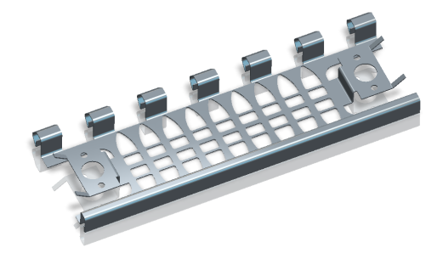
CREO PARAMETRIC – SHEETMETAL PART DESIGN
Fast creation of accurate sheetmetal designs and flat pattern geometry
Who Needs It?
Customers that need to design accurate sheetmetal parts and flat pattern geometry
Business Value
Reduce product costs
Reduce time-to-market
Reduce product development cost
Process Improvement
3D sheetmetal part design
Flat pattern geometry creation
Technology/ Capability
Fast creation of complex sheet metal parts
Pick and place creation of walls, hems, notches, bend relief, etc.
Direct editing of sheet metal walls and features
Fast creation and placement of sheet metal form features (louvers, bosses, ribs, etc.)
Automated creation of sheet metal flat patterns with accurate bend allowance calculations

Slide 3
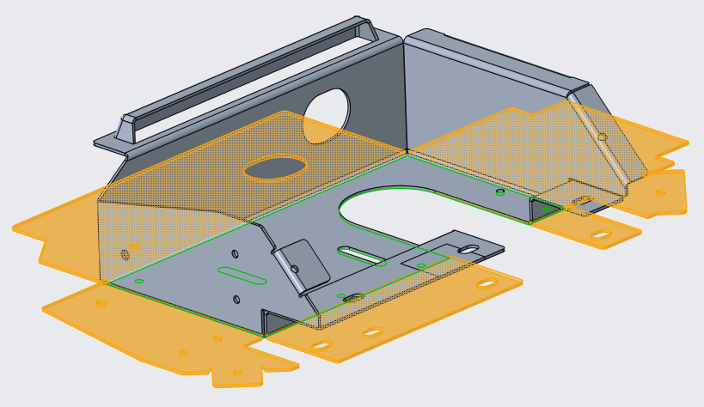
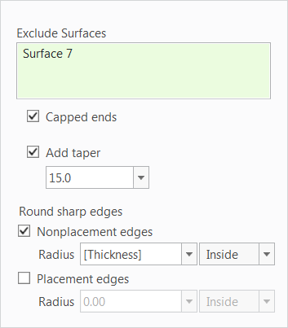
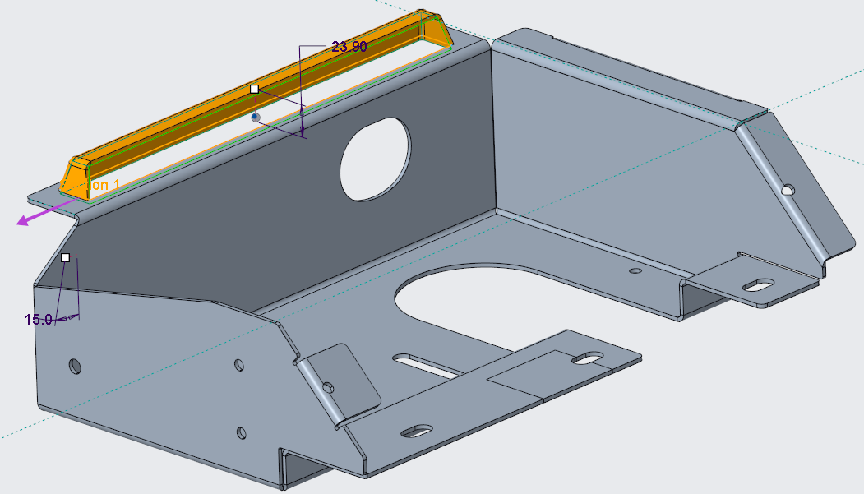
Product Introduction
What is Creo Sheetmetal Design?
Creo Sheetmetal Design is core functionality in Creo. Creo Sheetmetal design capabilities speed the creation of walls, bends, punches, notches, flanges and form geometry allowing engineers to quickly define accurate 3D designs and manufacturing flat patterns.

Slide 4
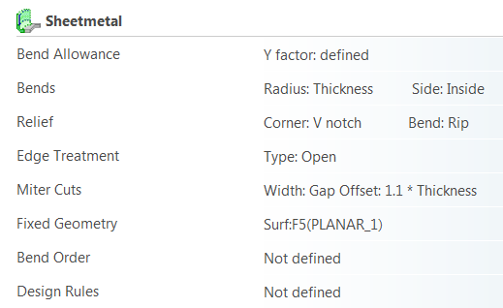
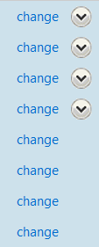
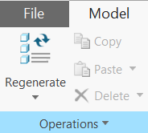
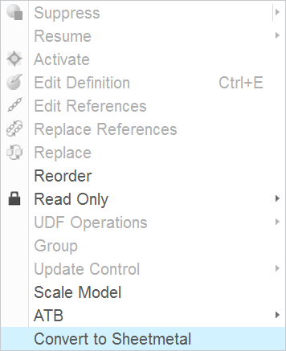
Product Introduction
What does the Creo Sheetmetal Design Provide?
Fast creation of complex sheet metal parts
Sheetmetal setup and tools
Design using standard and/or customized preferences
Specify and enforce company standard values and design rules
i.e., Bend Allowance, Bends, Relief and other preferences
Accurate developed lengths using Bend Tables to compensate for stretching
4 methods
System Equation (default)
Entered Value
Provided Bend Tables
User-defined (Customized) Bend Tables (*.bnd file)
Ability to create from “scratch” or convert from solid models
Simple process to convert solid models to sheetmetal
Import non-native geometry > make solid > convert to sheetmetal

Slide 5
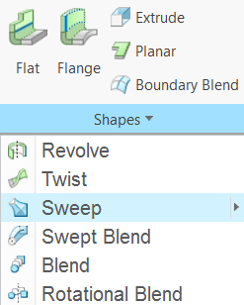
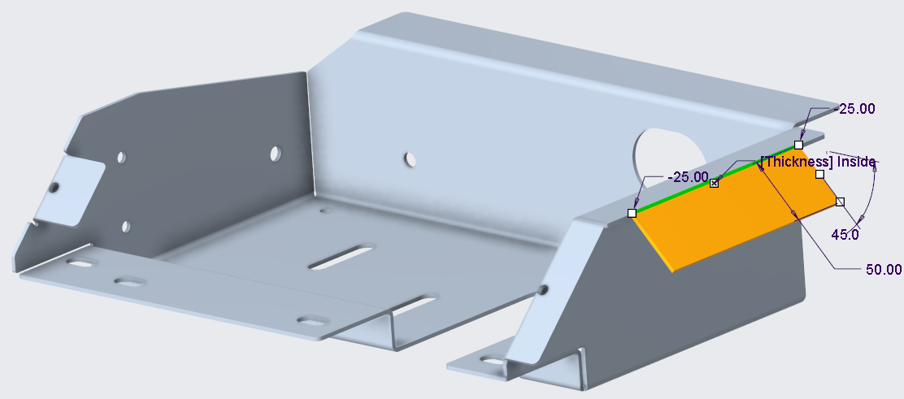
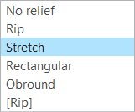
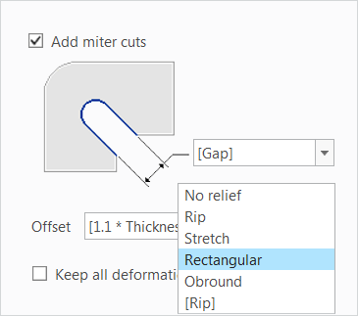
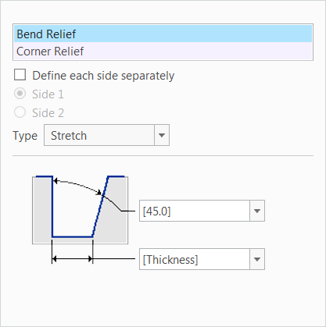
Product Introduction
Intuitive environment to rapidly design sheet metal parts
Common Creo command Ribbon UI
Consolidated menus and streamlined feature creation workflows
Fast sheet metal blank development
Quickly define sheetmetal walls and secondary geometry
Define planar, extruded, revolved, twist, boundary blends and sketched walls
Create advanced walls using variable section sweeps, blends and helical sweeps
Create walls and add secondary geometry in single operation
Define placement and sketch
Define and edit shape
Define Length
Define Offset
Specify Edge Treatment
Define Miter cuts
Specify Relief
Fast editing via drag handles

Slide 6
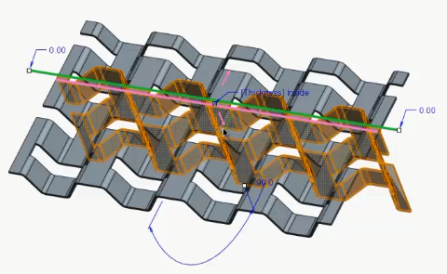
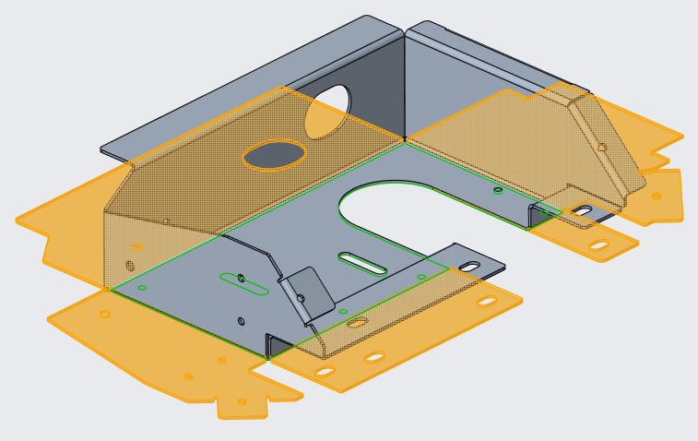
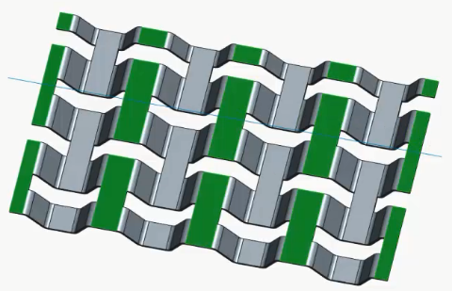
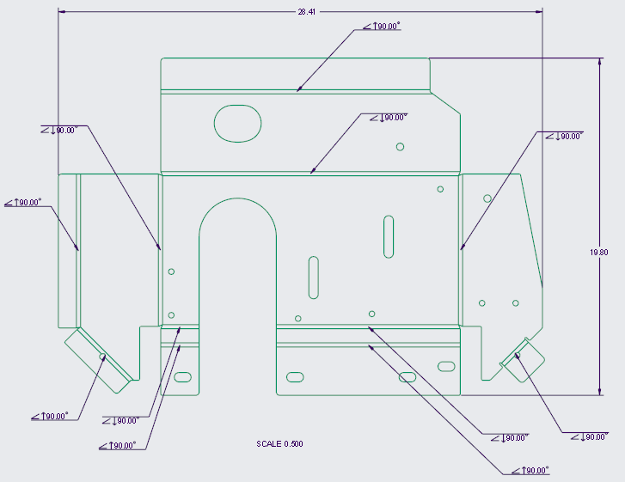
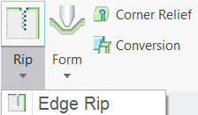
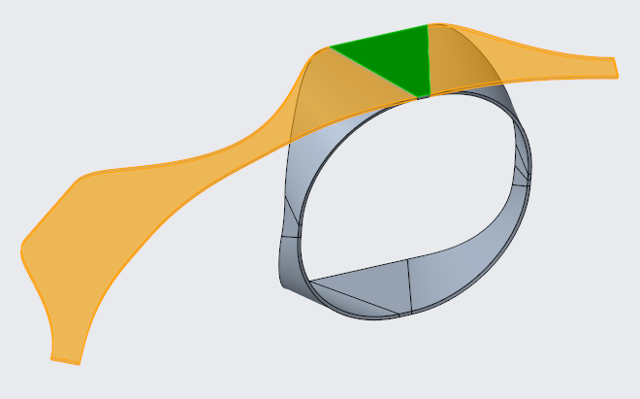
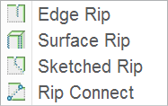
Product Introduction
Make fast direct edits to sheetmetal features
Double-click feature to directly edit geometry and parameters (drag handles)
Copy and Paste (Ctrl C/Ctrl V)
Define bend and unbend features to accurately model sheetmetal parts
Design in the bent and unbent state to capture manufacturing processes and operations
Create angle and roll type bends
Apply regular, transition and planar options
Define Planar and Co-Planer bends
Bend multiple co-planar, discontinuous surface in a single operation
Create Split Area features to unbend deformed areas
Create Rip feature (for unbend)
Create edge, surface, sketch and rip connect
One-click Flat Pattern creation
Fast creation of manufacturing Flat Patterns
Flat state includes all bend line information
Apply dimensions using Auto Ordinate tool
Define bend order sequence and create the bend order table

Slide 7
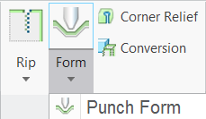
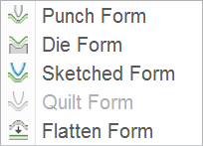
Product Introduction
Fast creation and placement of sheet metal form features (louvers, bosses, ribs, etc. )
Punch Form: creates a sheetmetal wall molded by a template
Die Form – creates an impression in a sheetmetal wall using asolid part
Sketched Form – creates forms that are sketch based
Exclude surface, cap ends, add taper, round edges
Quilt Form – creates forms that are quilt based
Flatten Form – used to unbend punch or die forms

