Slide 1
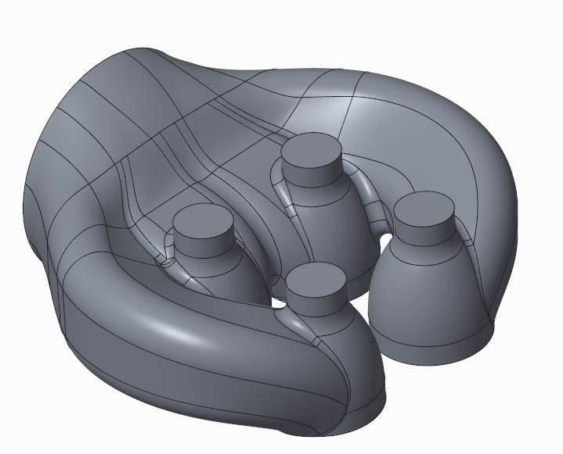
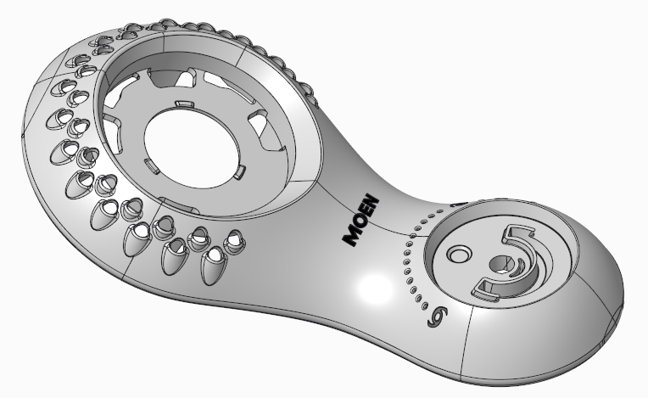
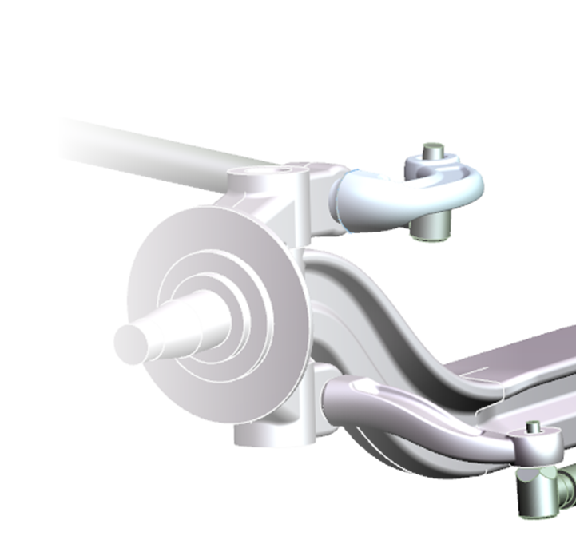
CREO PARAMETRIC SURFACING
Define parameter and constraint driven entities to create complex free-form and analytical surfaces
Who Needs It?
Customers that want to define free-form and analytical surfaces using parameters, constraints and calculations to define variable geometry and capture design intent
Business Value
Reduce time-to-market
Reduce product development cost
Increase styling and design to realize price premium
Process Improvement
3D part design and surface modeling
Complex part design frequently requires surfacing to handle complex geometry and design scenarios
Technology/ Capability
Easily model and edit complex surface geometry
Develop complex surface geometry using sweeps, blends, and boundary surfaces
Create analytic surfaces using extrude, revolve and fill tools
Drive complex surface geometry using mathematical equations and functions
Edit surfaces using trim, copy, merge and surface transform

