Slide 1
CREO PRISMATIC AND MULTI-SURFACE MILLING EXTENSION
Achieve the highest quality, highest precision machining in the fastest time possible
Who Needs It?
Customers that manufacture prototype products and/or tooling for plastic injection molded and casted components
Basic toolpaths effective for machining intricate core and cavity geometries in mold machining, and for quickly machining large, complex structural components out of solid blocks of aluminum
Business Value
Accelerate time-to-market
Reduce development and manufacturing costs
Improve quality of manufactured products
Increase customer satisfaction and win new business
Process Improvement
Integral CAD/CAM supporting concurrent design and manufacturing
Automatic change propagation and associative update of NC toolpaths
Automated creation of manufacturing process documentation
Technology/ Capability
Multi-surface 3-axis milling with 4- and 5-axis positioning
3 Axis Trajectory and basic holemaking sequences
GPOST: NC Post-Processor generator

Slide 2
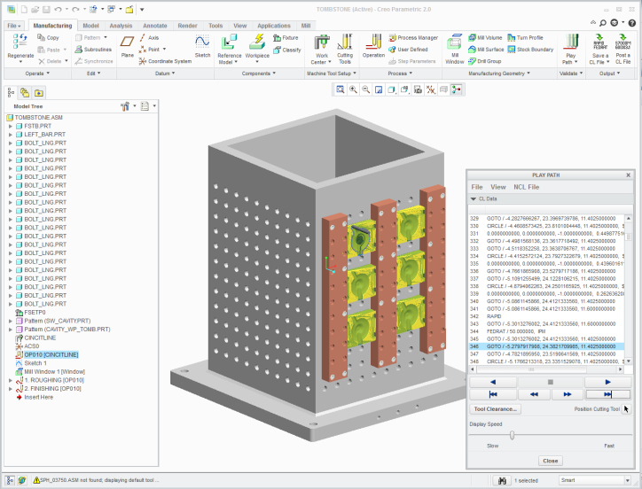
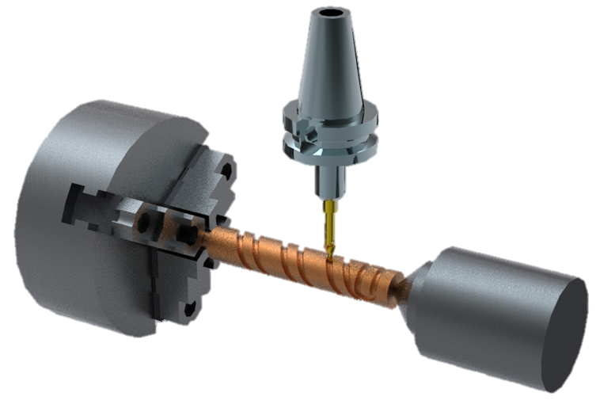
CREO PRODUCTION MACHINING EXTENSION
Rapidly creation and optimization of NC machining sequences to support production machining requirements
Who Needs It?
Customers that require NC programming capabilities and tool libraries to quickly create and optimize 3-axis milling, 2- and 4-axis turning, and 2- and 4-axis wire EDM toolpaths
Production Machining provides low-level NC sequence editing for toolpath control and NC toolpath optimization
Business Value
Accelerate time-to-market
Reduce development and manufacturing costs
Improve quality of manufactured products
Increase customer satisfaction and win new business
Process Improvement
Integral CAD/CAM supporting concurrent design and manufacturing
Automatic change propagation and associative update of NC toolpaths
Automated creation of manufacturing process documentation
Technology/ Capability
All the capabilities of PTC Creo Prismatic and Multi-surface Milling, :
Support for CNC mills, 2- and 4-axis CNC lathes, 2- and 4-axis CNC wire EDM
Low-level NC sequence editing for precise toolpath control and optimization
Tools to define step-by-step production planning instructions
GPOST: NC Post-Processor generator

Slide 3
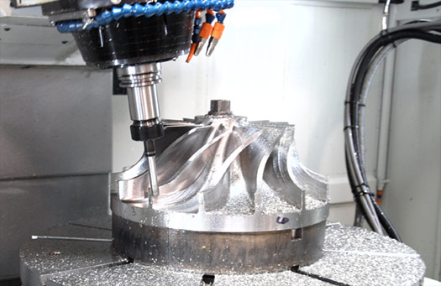
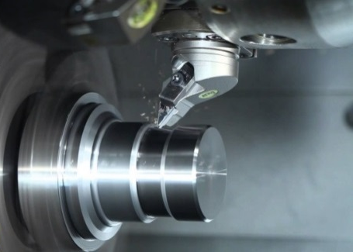
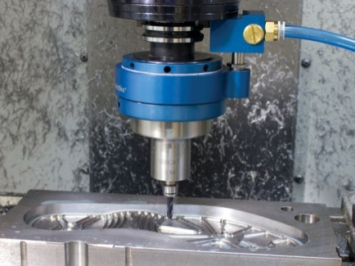
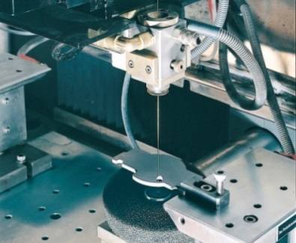
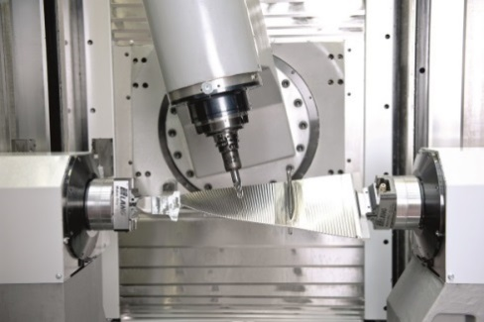
CREO COMPLETE MACHINING EXTENSION
Powerful, comprehensive NC machining capabilities to meet all production machining needs
Who Needs It?
Customers that require a complete NC programming solution to support advanced 2.5- to 5-axis CNC milling strategies, turning and wire EDM
Complete Machining provides support for advanced machining strategies and toolpath optimization for Multi-Tasking Machines.
Business Value
Accelerate time-to-market
Reduce development and manufacturing costs
Improve quality of manufactured products
Increase customer satisfaction and win new business
Process Improvement
Integral CAD/CAM supporting concurrent design and manufacturing
Automatic change propagation and associative update of NC toolpaths
Automated creation of manufacturing process documentation
Technology/ Capability
All the capabilities of Creo Production Machining Extension
Comprehensive holemaking
2.5- to 5-axis milling (advanced machining strategies)
Live tooling and multi-task machines synchronization
GPOST: NC Post-Processor generator

Slide 4
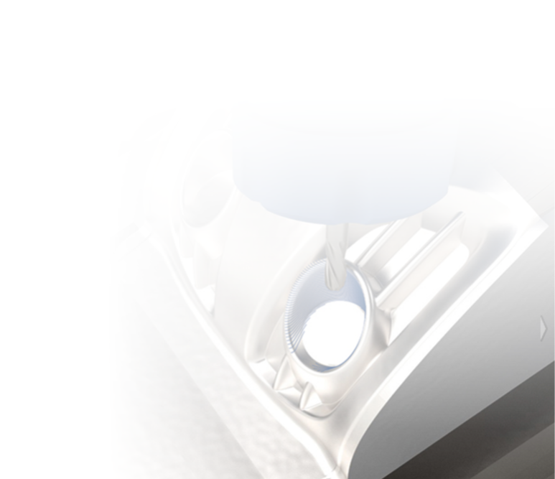
CREO HIGH SPEED MILLING EXTENSION
Rapid turn-around and delivery of production mold, die, electrode and prototype parts
Who Needs It?
Customers that requires high speed 3-axis machining capabilities for mold, die, electrode and prototype machining
High speed machining capabilities optimized for mold, die, electrode and prototype machining
Business Value
Accelerate time-to-market
Improve quality of manufactured products
Reduce development and manufacturing costs
Increase customer satisfaction and win new business
Creo High Speed Milling
HSM Rough
HSM Rest Rough
HSM Finish
HSM Rest Finish
Process Improvement
Integral CAD/CAM supporting concurrent design and manufacturing
Automatic change propagation and associative update of NC toolpaths
Automated creation of manufacturing process documentation
Technology/ Capability
High-speed 3-axis milling powered by ModuleWorks
Adaptive roughing and rest roughing
Finishing and rest finishing
3-axis trajectory milling
Basic holemaking
GPOST: NC Post-Processor generator

Slide 5
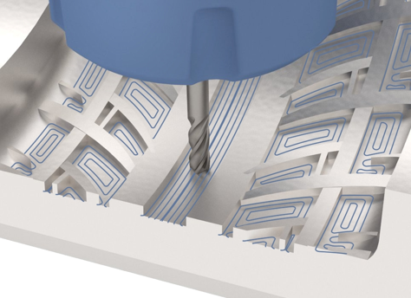
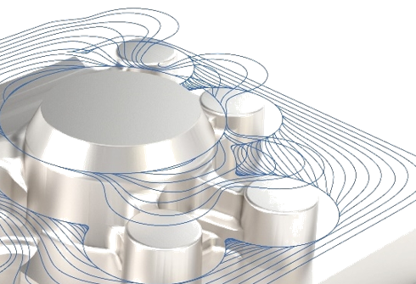
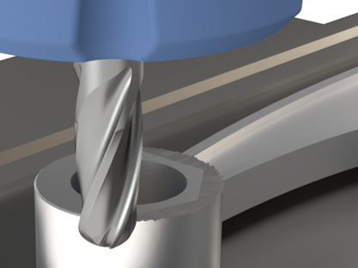
CREO HIGH SPEED MILLING ADVANCED EXTENSION
Rapid creation and computation of 3- and 5-axis high-speed milling sequences
Customers that requires 3- and 5-axis high speed machining capabilities for rapid production and manufacturing
High speed machining increases manufacturing efficiency and productivity
Creo High Speed Milling Advanced
Who Needs It?
New in Creo 8.0
Business Value
Accelerate time-to-market
Improve quality of manufactured products
Reduce development and manufacturing costs
Increase customer satisfaction and win new business
(3 and 5-axis HSM)
Expanded partnership with ModuleWorks Includes existing 3-axis HSM capabilities
Adds 7 new 5-axis HSM toolpaths
Process Improvement
Integral CAD/CAM supporting concurrent design and manufacturing
Automatic change propagation and associative update of NC toolpaths
Automated creation of manufacturing process documentation
Technology/ Capability
All the capabilities of Creo High Speed Milling
5 Axis High-speed milling (HSM) roughing, rest roughing, including automatic 3+2 axis roughing and rest roughing
3to5 axis high-speed milling (HSM) conversion for finish and rest finish toolpaths
5 axis auto deburring
Comprehensive holemaking
GPOST: NC Post-Processor generator

Slide 6
Creo Manufacturing Comparison Chart
 | Functionality | Prismatic & Multi-Surface Milling | Production Machining | Complete Machining | High Speed Milling | High Speed Milling Advanced | NC Sheetmetal
NC Machine type | 2 ½ Axis Feature Based Machining | ✔ | ✔ | ✔
 | 3 Axis Milling | ✔ | ✔ | ✔
 | 3 Axis High-speed Milling (HSM) Roughing, Rest Roughing, Finish and Rest Finish |  |  |  | ✔ | ✔
 | 5 Axis High-speed milling (HSM) Roughing, Rest Roughing, including automatic 3+2 Axis Roughing and Rest Roughing |  |  |  |  | ✔
 | 3to5 Axis High-speed Milling (HSM) Conversion for Finish and Rest Finish toolpaths |  |  |  |  | ✔
 | 5 Axis Auto Deburring |  |  |  |  | ✔
 | Basic Holemaking | ✔ | ✔ | ✔ | ✔ | ✔
 | Comprehensive Holemaking |  |  | ✔ |  | ✔
 | 3 Axis Trajectory | ✔ | ✔ | ✔ | ✔ | ✔
 | 2-4 Axis Turning |  | ✔ | ✔
 | 2-4 Axis Wire EDM |  | ✔ | ✔
 | Live Tooling for Turning (Mill/Turn) |  |  | ✔
 | 5 Axis Continuous Milling, including 5 Axis Trajectory |  |  | ✔
 | Multi-task Machining Synchronization |  |  | ✔
 | Dynamic Tool Axis Definition in Turning |  |  | ✔
Mfg. productivity tools | Extraction of Manufacturing Annotation Features | ✔ | ✔ | ✔ | ✔ | ✔
 | Tool and Fixture library | ✔ | ✔ | ✔ | ✔ | ✔
 | Manufacturing Process Documentation Pro/PROCESS for Manufacturing | ✔ | ✔ | ✔
 | Automatic Nesting |  |  |  |  |  | ✔
 | Punch Press and 2 Axis Laser Programming |  |  |  |  |  | ✔
Post & Sim. | Creo/NC-GPOST : NC Post-processor generator | ✔ | ✔ | ✔ | ✔ | ✔ | ✔
 | Moduleworks-based Material Removal | ✔ | ✔ | ✔ | ✔ | ✔

