Slide 1
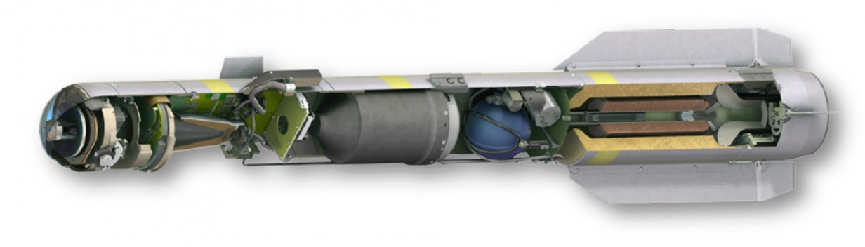
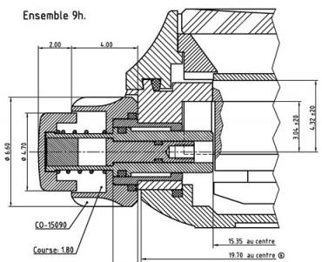
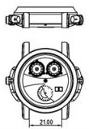
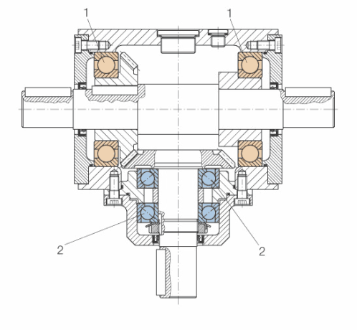
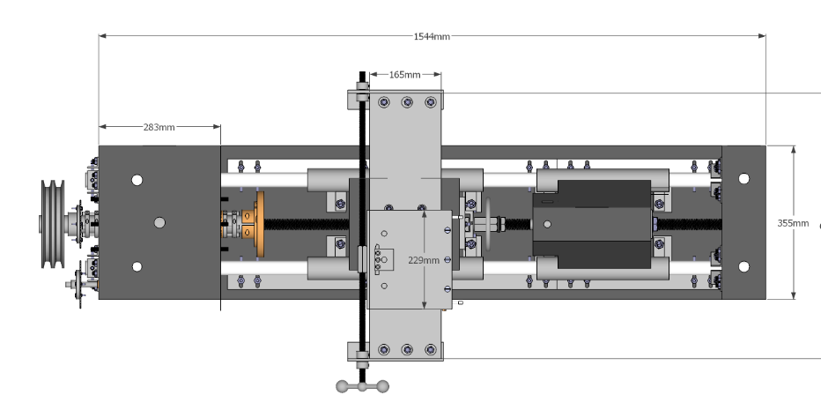
CREO LAYOUT
Maximize productivity using integral 2D layout and 3D detailed design
Who Needs It?
Customers that create products using 2D layouts to conceptualize and support design
Machine design, gear design, and axi-symmetric products are easily defined in 2D
Business Value
Reduce time-to-market
Reduce product development cost
Improve product quality and innovation
Process Improvement
2D concept and layout design
Transition from 2D layout to 3D detailed design
Technology/ Capability
Easily create from scratch or edit existing information
Directly utilize 2D data to speed the creation of 3D design
Implement changes driven from 2D layout information

