Slide 1
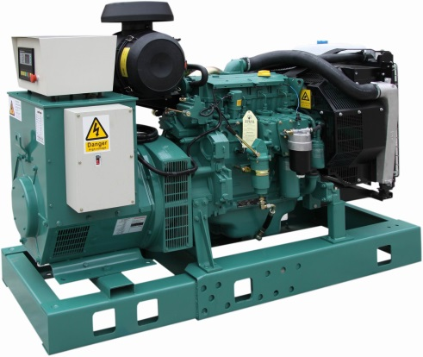
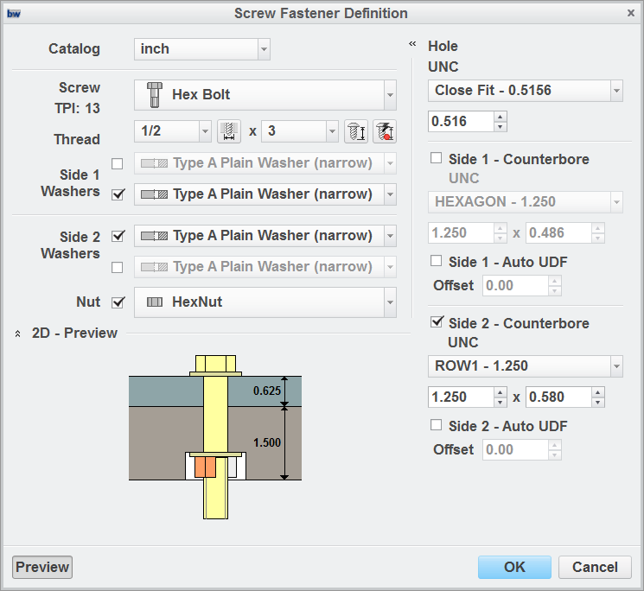
CREO INTELLIGENT FASTENER EXTENSION (IFX)
Capabilities to automate fastener geometry creation and hardware assembly
Who Needs It?
The target customer creates products that require assembly fabrication and/or scheduled service and maintenance
Fastener assembly allows equipment to be assembled and dis-assembled for transport, service and maintenance
Business Value
Reduce time-to-market
Reduce product development cost
Process Improvement
Fastener standardization and selection
Clearance and alignment geometry creation
Fastener and configuration hardware assembly
Fastener validation
Technology/ Capability
Rapid fastener and hardware selection
Automatic creation of fastener geometry
Automatic placement of fastener and configuration hardware

