Slide 1
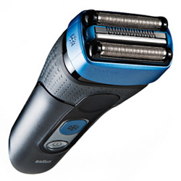
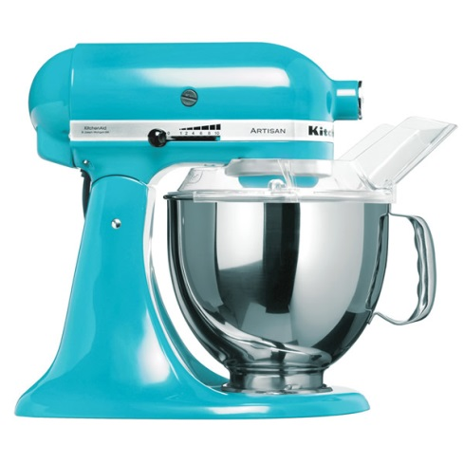
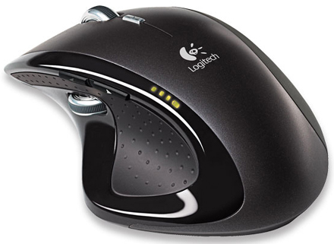
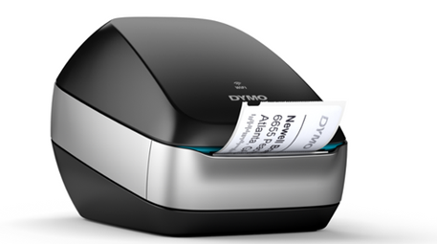
CREO INTERACTIVE SURFACE DESIGN (ISDX)
Combine the power of parametric modeling and flexibility of freeform surfacing
Who Needs It?
Any customer that needs to differentiate and capture competitive differentiation using freeform design to satisfy aesthetic, ergonomic and functional design requirements
Commodity products require styling to provide competitive differentiation
Business Value
Reduce time-to-market
Reduce product development cost
Improve product styling and competitive differentia
Process Improvement
Freeform surface creation
Concept and industrial design
Technology/ Capability
Combined freeform and technical surfacing in a single environment
Focus on design aesthetics and shape rather than constraints and parameters
Design precise curves and surfaces to achieve highly-engineered, manufacturable products
Confidently explore design variants leveraging direct curve and surface editing capabilities and real-time feedback

