Slide 1
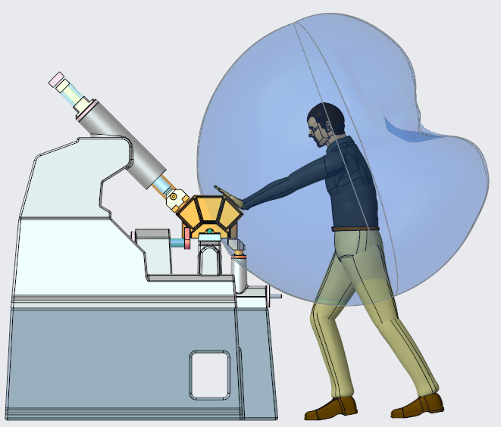
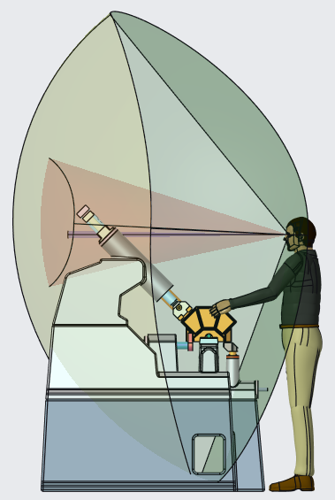
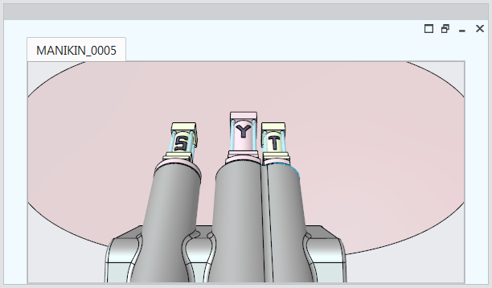
CREO HUMAN FACTORS EXTENSION
Validate and optimize products for human interaction, usability and safety
Who Needs It?
Customers that need to optimize products for human interaction, safety, comfort and usability
Business Value
Reduce time-to-market
Reduce product development cost
Validate product usability and human interaction
Process Improvement
Design for human interaction
Technology/ Capability
Quickly insert and customize digital human models
Manikin libraries speed the selection and reuse of manikin data
Easily manipulate manikin posture using standard Creo Parametric functionality
Define vision cones and reach enveloped to validate design considerations and field of view
Create vision windows to “see” what the manikin can see

