Slide 1
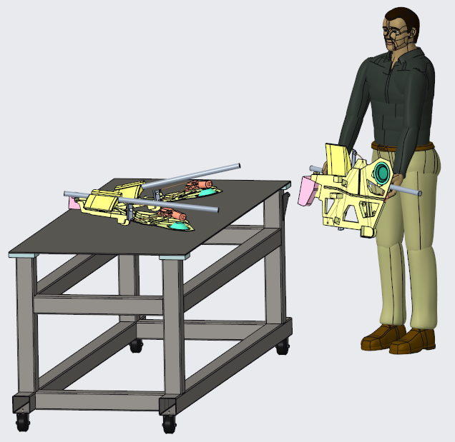
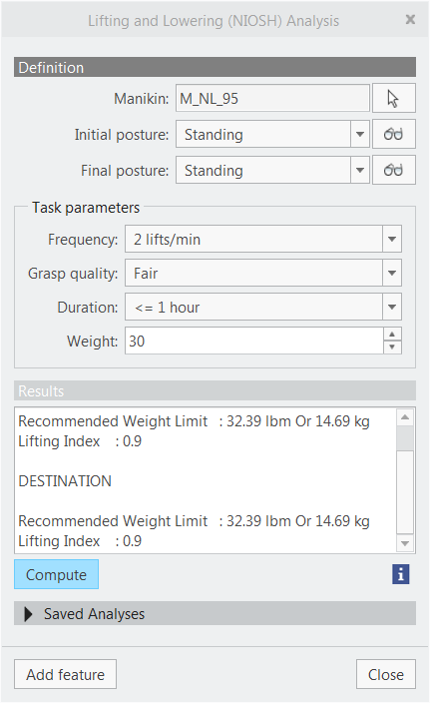
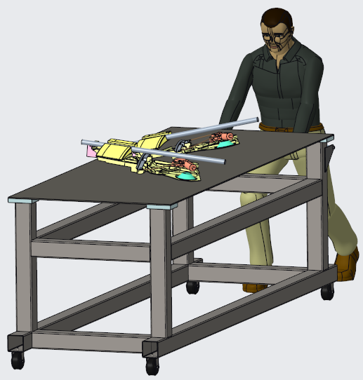
CREO HUMAN FACTORS ANALYSIS EXTENSION
Validate designs and demonstrate compliance with safety, health and workplace standards
Who Needs It?
Customers that need to analyze human interaction and demonstrate compliance with safety, health and workplace standards
Business Value
Standards compliance
Reduce time-to-market
Reduce product development cost
Process Improvement
Conformance with safety, health and workplace standards
Technology/ Capability
Validate designs against workplace standards and guidelines for:
Material Handling (RULA), Pushing/Pulling (Snook), Lifting/Lowering (Snook), Carrying (Snook) and Lifting/Lowering (NIOSH)
Define and save manikin postures associated with the analysis
Reuse and apply saved positions for target populations
Identify and validate acceptable limits for the desired population
Reuse and repeat the analysis for different populations and criteria

