Slide 1
What is Creo Generative Design?
AI-driven Generative Design automatically delivers innovative solutions optimized to your engineering and manufacturing requirements.
Innovative, Differentiated Products
Improve Time-to-Market
Reduce Product Costs & Development Expense
High-Quality, Manufacturable Designs
Notes:
Creo Generative Design is a new tool that addresses all of these issues. But what exactly is it?
GD uses artificial intelligence to automatically optimizes your design based on your constraints and requirements, including materials and manufacturing process.
The results?
Innovative products are differentiated, driving customer-demand
High-performance products delivered faster than ever before.
Lower product costs and development expense to protect your profit margin
And finally, the designs are durable and ready to manufacture.

Slide 2
Why is Generative Design Important?
Generative Design will drive a fundamental shift in productivity across the organization.
Capture new business
Increase engineering productivity
Reduce manufacturing cost
Improve quality and service efficiency
Notes:
Generative design can help unleash digital transformation across the entire enterprise.
Capture new business with innovative, differentiated products that you can bring to market faster.
Watch engineering productivity soar as you spend more time on design outcomes and less time on trial and error.
As experienced engineers retire, some companies struggle with a skills gap. Generative Design helps empower junior engineers with the skills to deliver high-quality, manufacturable designs.
And finally, manufacturing, quality and service teams will appreciate the higher-quality, lower-cost product designs.

Slide 3
Generative Design with Creo
Generative Topology Optimization Extension (GTO)
Easy to set up a design study, defining the objectives, constraints, material and manufacturing process.
Quickly yields a parametric, manufacturable design that can be further refined.
Cloud-based Generative Design Extension (GDX)
Simultaneously solve for multiple material and manufacturing options, yielding design solutions you may not have considered.
Both seamlessly integrate with Creo and work for traditional and additive manufacturing.
Notes:
Creo offers two extensions to help you on your Generative Design journey.
GTO makes it easy to set up a design study, right from the familiar Creo design toolbar. You can set your loads, dimensions and keep-out areas, as well as your material and preferred manufacturing process. GTO works for additive and traditional manufacturing, too. In just a few minutes you’ll have an optimized design that you can produce or further refine.
GDX takes it one step further. Using the power of the PTC Atlas cloud, you can simultaneously explore a variety of materials and manufacturing processes. Before you know it, you will be seeing dozens of optimized solutions from which to choose, including some you may not have even considered.
Because both are integrated into the Creo design environment, it is easy to set-up, with parametric results you can modify. You can use the b-rep geometry as a final product or modify as you see fit. You can even run additional simulations on your design.
And best of all, it works for traditional manufacturing methods, like machining and casting, as well as 3D print additive manufacturing.

Slide 4
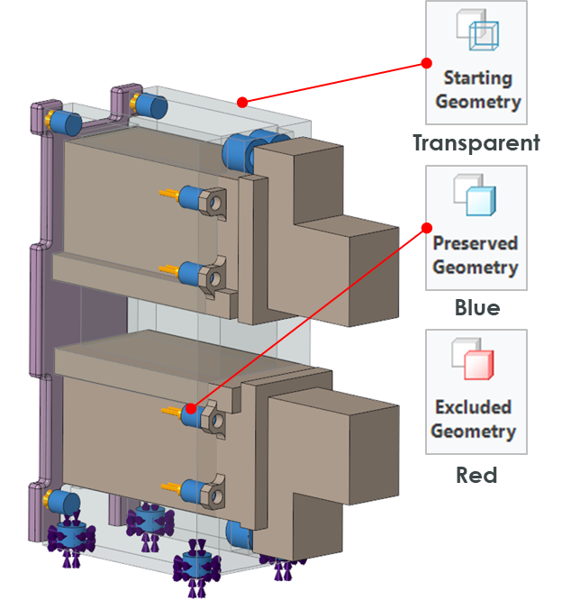
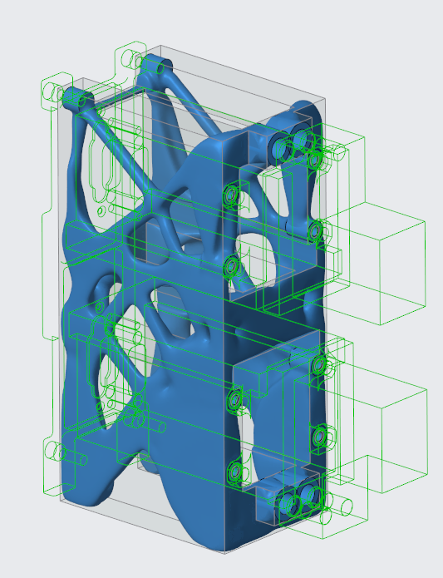
Generative Topology Optimization (GTO)
Deliver your best designs in less time
Easy to use
Fast
Interactive
Manufacturing Ready
Seamlessly integrated
Notes:
GTO helps you deliver your best designs in less time.
Ease of Use – Set up loads, constraints and boundary conditions. Pick your material and manufacturing process.
Fast – In seconds - the part is optimized for your requirements.
Interactive - Change your constraints or material, and the results update dynamically.
The design is optimized for the manufacturing process you choose – traditional or additive. Results are tessellated geometry or full B-rep CAD geometry.
And because it is seamlessly integrated into Creo, there are no disconnected processes and no need to recreate data. The results fit into your parametrically driven workflow.

Slide 5
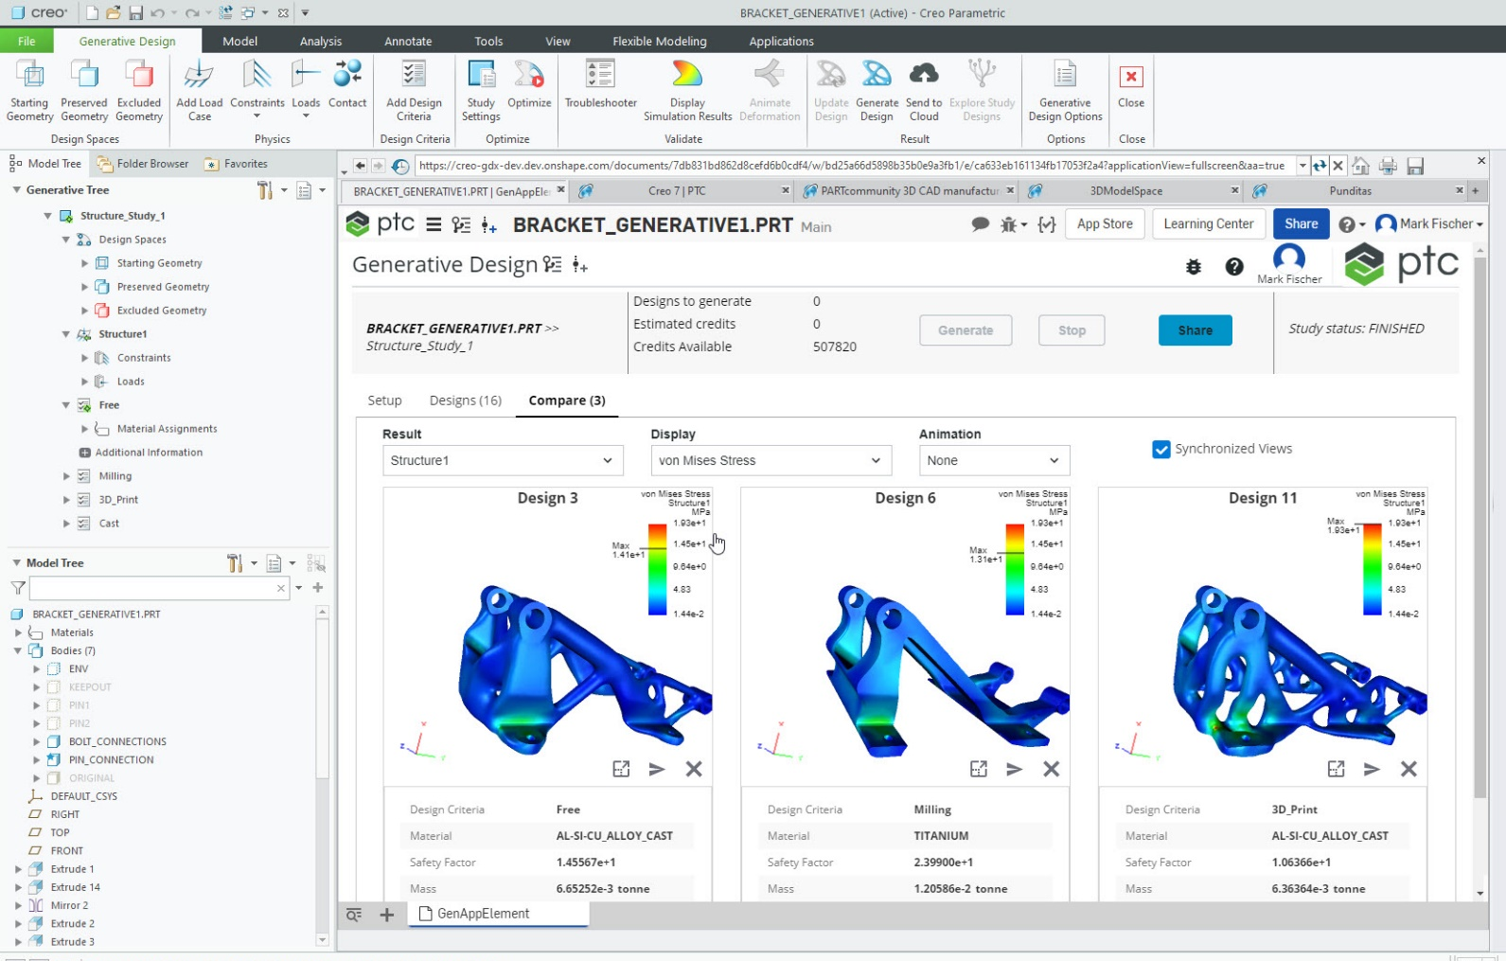
Generative Design Extension (GDX)
GDX runs on the Atlas Cloud
Simultaneously develop multiple products based on your requirements – including different materials and manufacturing processes
Cloud Technology
Powerful
Intuitive
Notes:
Cloud-based GDX lets you explore and compare more design options, faster than ever before.
With cloud technology, you can quickly develop multiple innovative designs, including options that you may not have considered.
Powerful - Quickly run dozens of combinations of materials and manufacturing processes. Compare stress and displacement for each solution
Intuitive - Use dynamic filters to highlight top options and visually compare up to three solutions.

