Slide 1
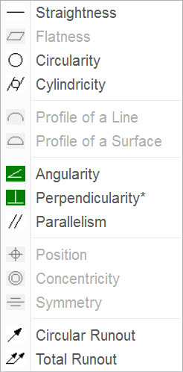
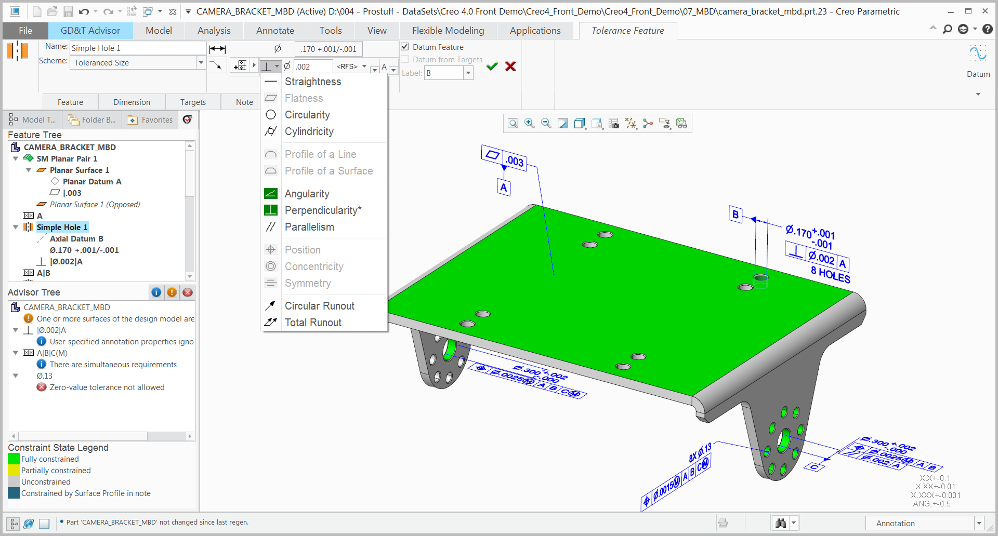
CREO GD&T ADVISOR EXTENSION
Simplify GD&T creation and improve MBD compliance with latest standards (ASME & ISO)
Who Needs It?
Every customer that documents model and manufacturing requirements using Geometric Dimensioning and Tolerancing (GD&T)
Business Value
Reduce time-to-market
Improve product quality and innovation
Reduce product development and manufacturing costs
Improve collaboration and communication
Only relevant options are available for user selection
Process Improvement
GD&T authoring (4 times faster than Creo Authoring)
Model-based Definition (MBD)
Technology/ Capability
Wizard-like dashboard to guide the user in the correct application of GD&T
Feature-centric view of GD&T
Advisor Tree – displays messages to inform and guide the user
Constraint State Legend – provides surface highlighting to indicate tolerance status

Slide 2
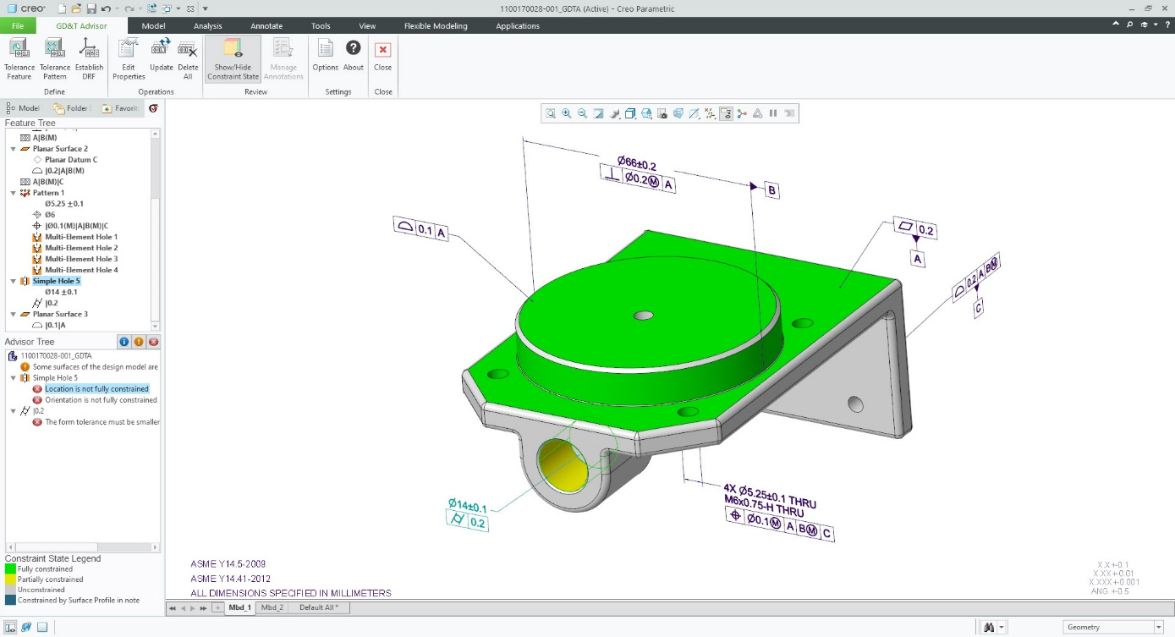
GD&T Advisor Basic and Advanced
Capability | GD&T Advisor Basic SPN-3391 | GD&T Advisor Advanced SPN-3376
Guided creation of GD&T in part models | ✔ | ✔
Guided creation of GD&T in assembly models |  | ✔
Validation against ASME and ISO GPS tolerance standards ** | ✔ | ✔
Receive info, warnings and error messages in Advisor Tree | ✔ | ✔
Reuse existing 3D annotation created in Creo using GD&T Advisor to evaluate and provide guidance to fix non-compliant GD&T (per standards) |  | ✔
**Note:
ASME and ISO GPS Tolerance standards are defined for part level GD&T Only
Assembly GD&T is applied according to part level standards

