Slide 1
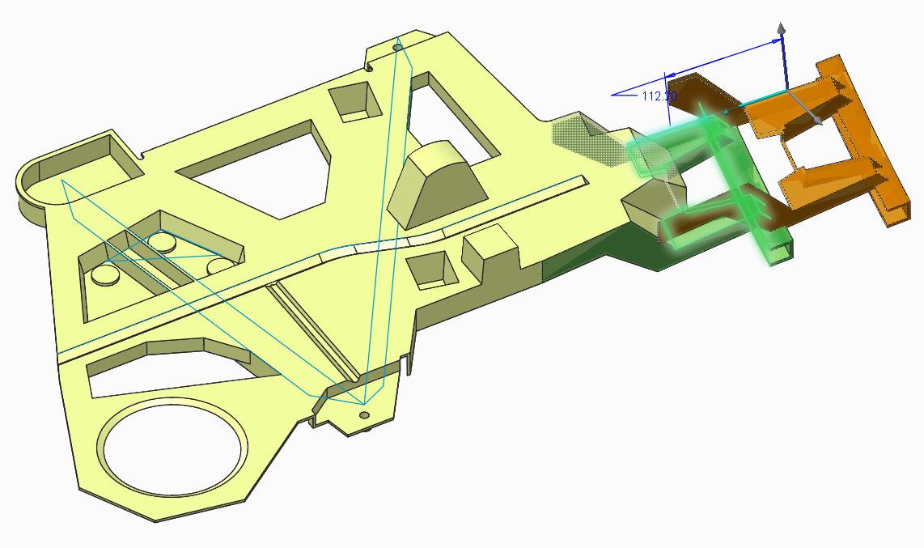
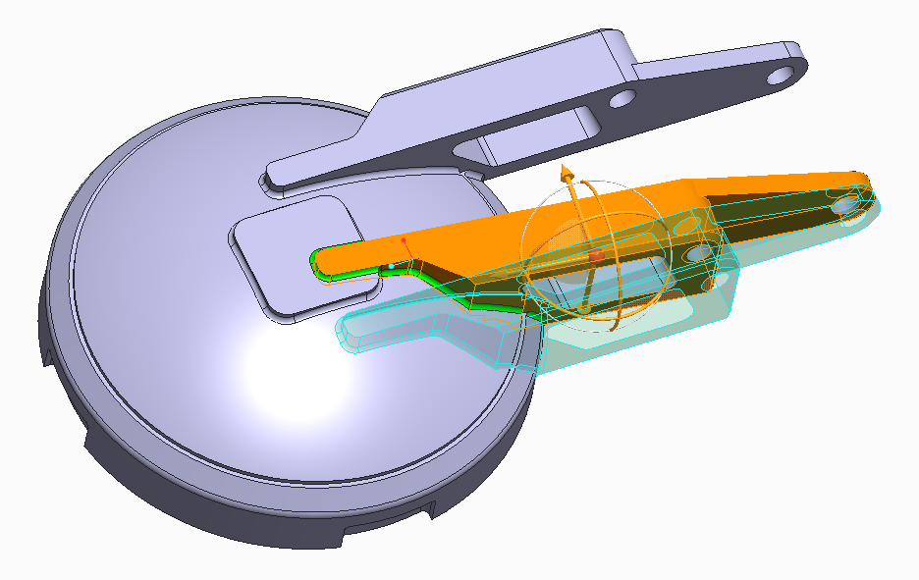
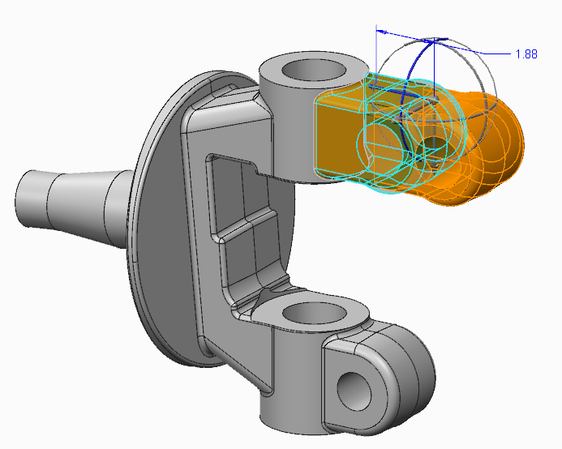
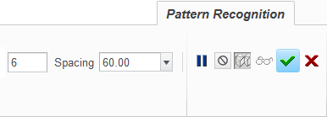
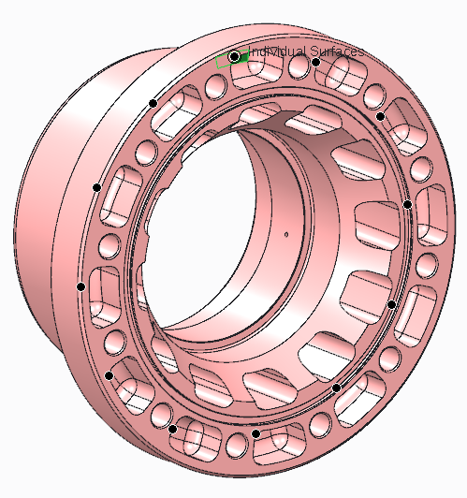
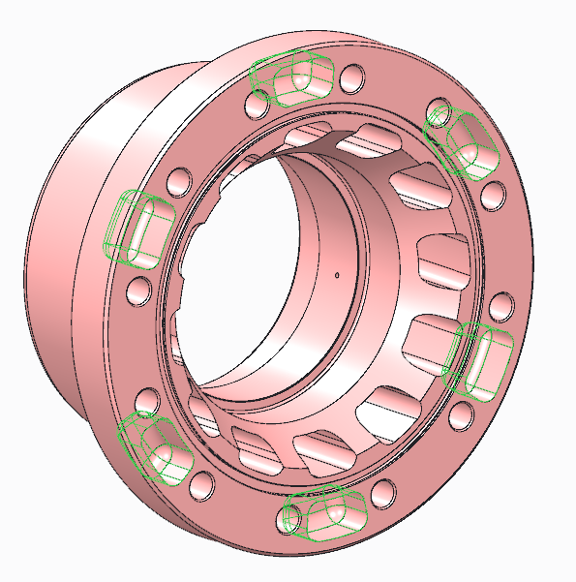
CREO FLEXIBLE MODELING (FMX)
Capabilities to directly edit any 3D geometry in Creo Parametric
Who Needs It?
All customers that need to work with and edit multi-CAD from suppliers, partners and extended design teams
Business Value
Reduce time-to-market
Reduce product development cost
Improve product quality and innovation
Process Improvement
Multi-CAD Design
Late Stage and Unexpected Change
Rapid Design Exploration and Reuse
Model Prep and Simplification
Technology/ Capability
Support multi-CAD Collaboration and Consolidation efforts
Rapidly implement late stage and unexpected design change
Speed design exploration and enable CAD data reuse
Prepare models for analysis and downstream use

