Slide 1
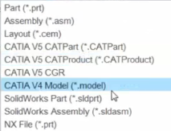
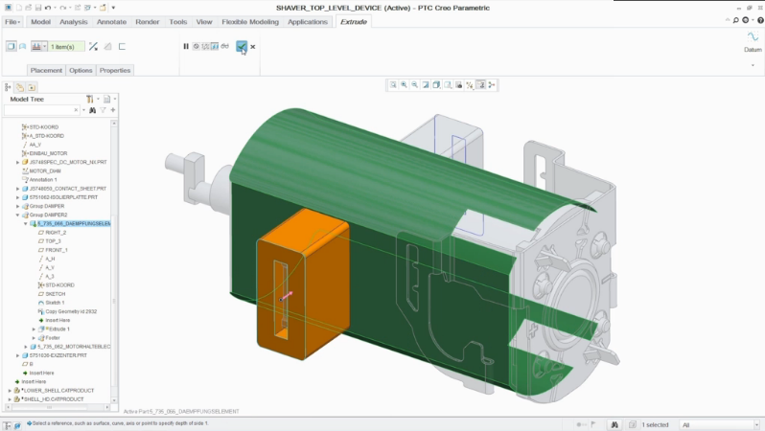
CREO COLLABORATION EXTENSIONS
Easily integrate and work with data from CATIA V4/V5, SolidWorks, Siemens NX and Inventor
Who Needs It?
Every customer that needs to integrate and work with data from CATIA, SolidWorks, Siemens NX and Inventor
Business Value
Reduce product cost
Reduce time-to-market
Reduce product development cost
Improve product quality and innovation
Process Improvement
Multi-CAD Design Collaboration and Consolidation
CATIA V4, CATIA V5, SolidWorks, Siemens NX and Inventor
Technology/ Capability
PTC Creo Collaboration Extensions are available for CATIA V4, CATIA V5, SolidWorks, Siemens NX and Inventor
“Save As” native CATIA V4/V5, SolidWorks and Siemens NX file formats
Note: Inventor Collaboration Ext. does NOT support Save As
Automatically detect and update out of date information

Slide 2
CREO UNITE TECHNOLOGY
Format | Import | Open | Update | Save As
CATIA V4 | ✔ | ✔
CATIA V5 | ✔ | ✔
Siemens NX / Unigraphics NX | ✔ | ✔
SolidWorks | ✔ | ✔
JT
CADDS 5 | ✔ |  | ✔ | ✔
Creo Elements/Direct | ✔ | ✔ | ✔
STEP | ✔ |  |  | ✔
Autodesk Inventor | ✔ | ✔
Rhinoceros | ✔
SolidEdge | ✔
AutoCAD DXF | ✔ |  |  | ✔
AutoCAD Drawing | ✔ |  |  | ✔
NEW IN CREO 5.0
For the latest support information, please view the compatibility matrix.
✔
Base license of Creo Parametric
Requires Collaboration Extension Purchase
Requires Creo Interface for JT

