Slide 1
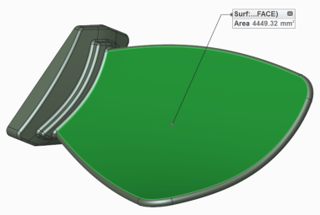
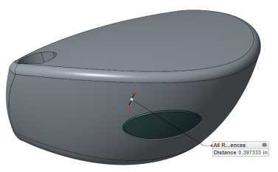
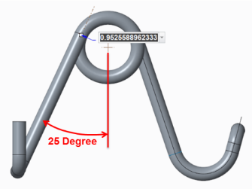
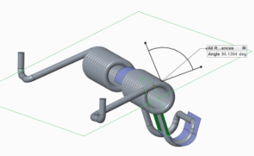
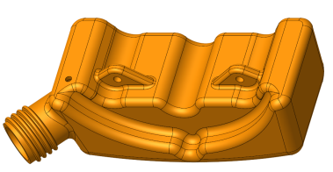
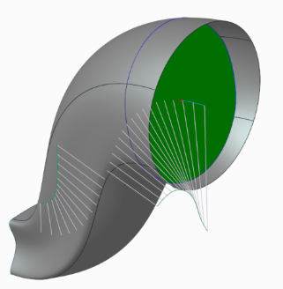
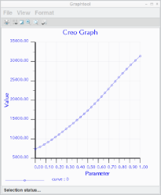
CREO BEHAVIORAL MODELING (BMX)
Rapidly optimize geometry to solve for design goals and engineering criteria
Who Needs It?
All customers using iterative solving to capture geometry requirements, solve for design criteria and define complex measures
Design (exploration)
Determine the point ratio that will result in 25 degree spring angle
Design evaluation and tracking
Demonstrate x-sectional area through duct
Business Value
Speed time-to-market
Reduce product development cost
Improve product quality and innovation
Increase customer satisfaction and competitive differentiation
Process Improvement
Design optimization and exploration
Model performance and information tracking
Design Optimization
Optimize surface area of blade
Move location of CoG to specify sweet spot
Optimize shape to achieve desired volume
Technology/ Capability
Automatically solve for design goals
Create smart models that adapt to change
Define and track custom measures
Notes:
.

