Slide 1
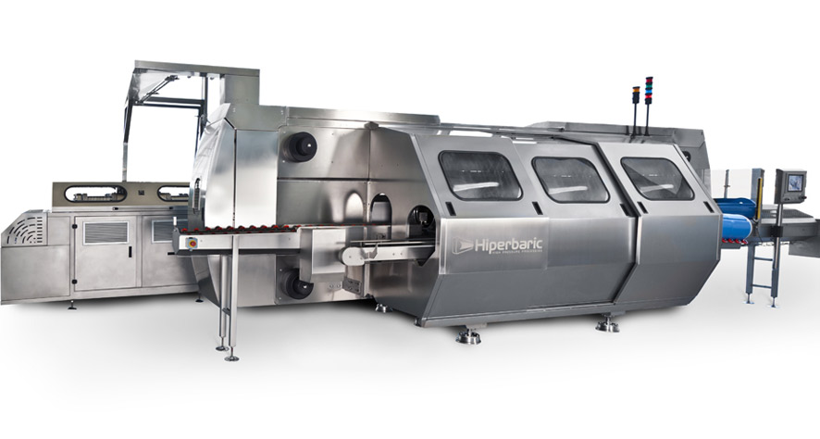
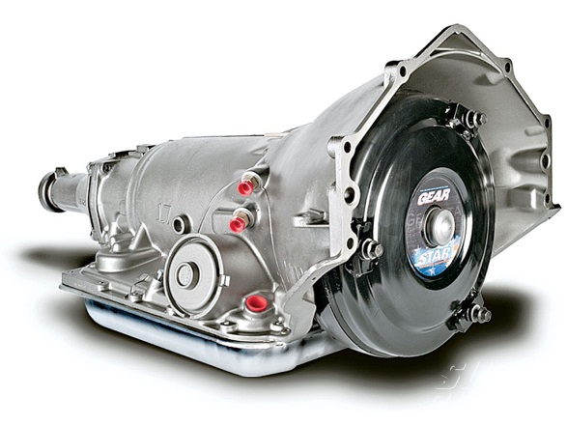
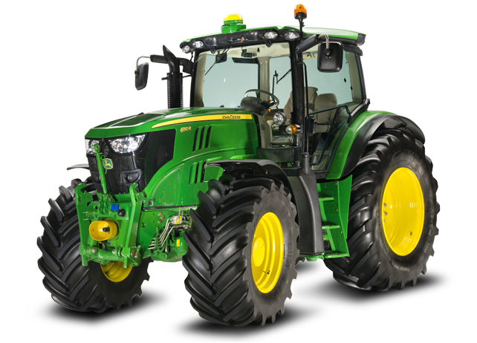
CREO ADVANCED ASSEMBLY (AAX)
Capabilities to facilitate and support concurrent design and development
Who Needs It?
All customers that requires top-down design tools to capture design intent and manage the concurrent design process
Business Value
Reduce time-to-market
Reduce product development cost
Improve product quality and innovation
Process Improvement
Concurrent design using top-down design
Data sharing and distribution
Reference control
Change propagation
Technology/ Capability
Define and manage design intent
Securely share and communicate design criteria
Establish and enforce design best practices
Implement predictable change

