Slide 1
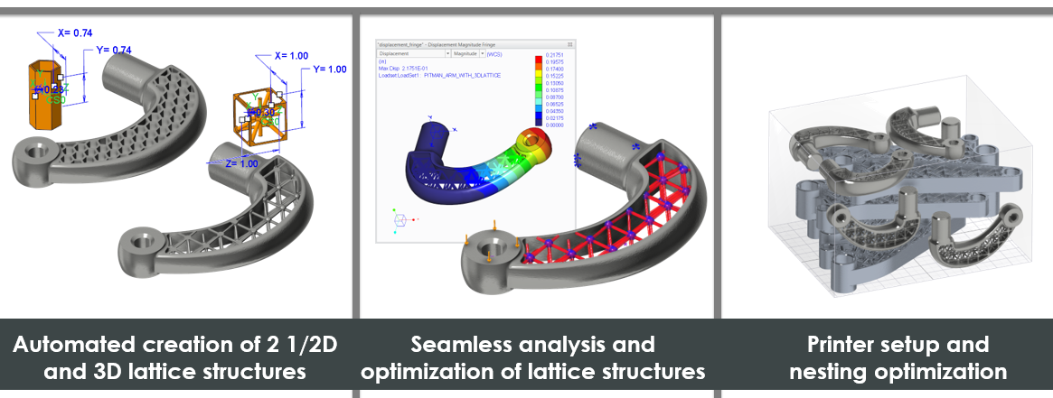
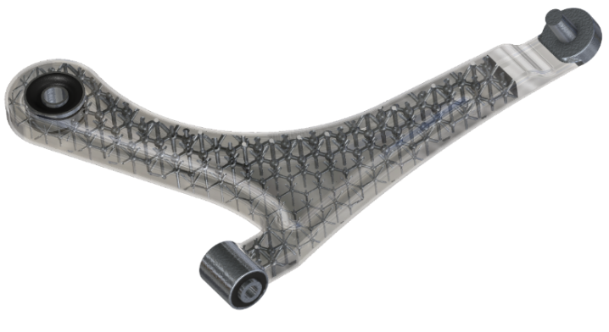
CREO ADDITIVE MANUFACTURING EXTENSION
Rapidly create and optimize lattice structures and define printer tray setup
Who Needs It?
Every customer that wants to innovate and exploit the value of additive manufacturing
Lattice creation and optimization creates new opportunities to exceed product quality, performance and durability standards
Business Value
Reduce Time-to-market
Reduce Product Development Cost
Accelerate New Product Introduction
Improve Product Quality and Innovation
Process Improvement
Design for additive manufacturing
Automatic creation and optimization of lattice structure
Technology/ Capability
Automated creation of 2 ½ D and 3D lattice structures
Full B-rep geometry (NOT an approximation using facet geometry)
Seamless analysis and optimization of lattice structure
Lattices are optimized using Creo Simulate
Printer tray setup and nesting optimization

