Slide 1
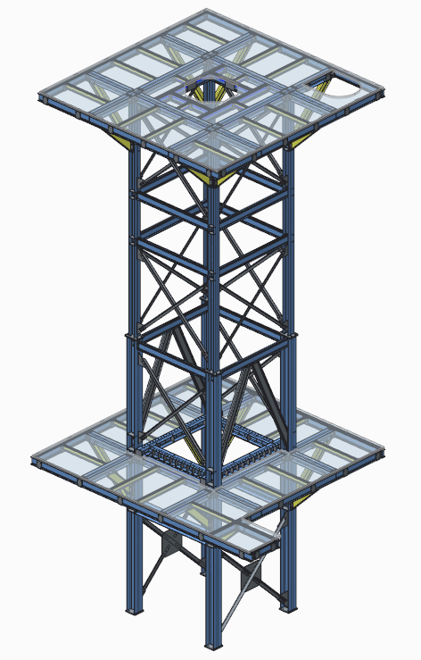
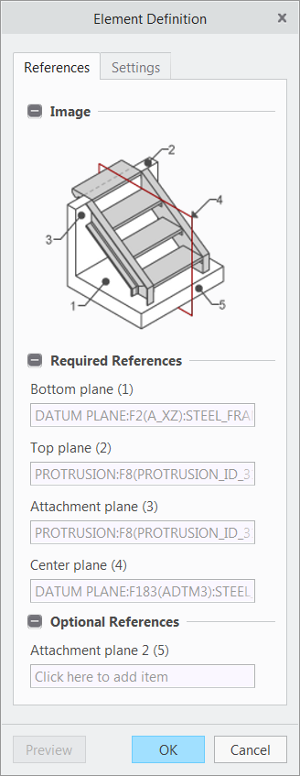
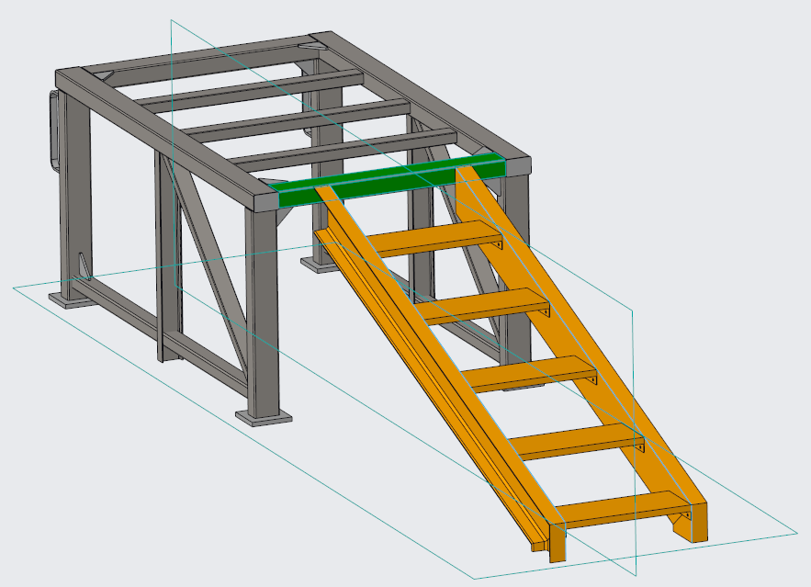
CREO ADVANCED FRAMEWORK DESIGN (AFX)
Speed design and improve the accuracy of structural framework assemblies
Who Needs It?
All customers that create structural framework assemblies for building structures, machinery and assembly lines
Business Value
Reduce time-to-market
Reduce product development cost
Improve product quality and innovation
Process Improvement
Structural framework design
Fastener assembly
Weldment design
Technology/ Capability
Intuitive, easy to use process driven UI
Fully integrated modeling, framework design and analysis
Comprehensive and customizable libraries of profiles, joints, connections and equipment
Automated beam placement and creation of framework geometry (e.g., joints, connections)
Automated creation of BOMs, production drawings and fabrication data

