Slide 1
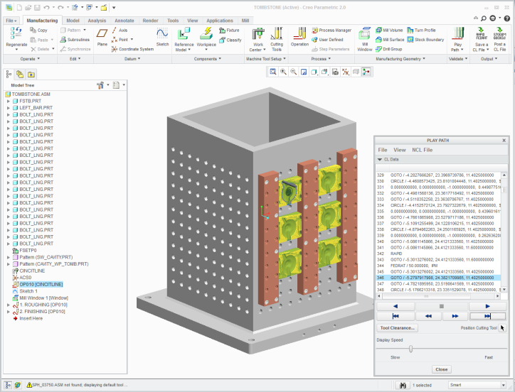
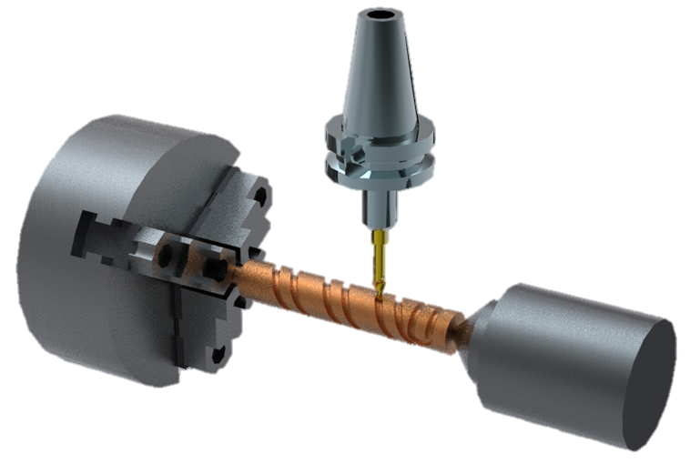
CREO PRODUCTION MACHINING EXTENSION
Rapidly creation and optimization of NC machining sequences to support production machining requirements
Who Needs It?
Customers that require NC programming capabilities and tool libraries to quickly create and optimize 3-axis milling, 2- and 4-axis turning, and 2- and 4-axis wire EDM toolpaths
Production Machining provides low-level NC sequence editing for toolpath control and NC toolpath optimization
Business Value
Accelerate time-to-market
Reduce development and manufacturing costs
Improve quality of manufactured products
Increase customer satisfaction and win new business
Process Improvement
Integral CAD/CAM supporting concurrent design and manufacturing
Automatic change propagation and associative update of NC toolpaths
Automated creation of manufacturing process documentation
Technology/ Capability
All the capabilities of PTC Creo Prismatic and Multi-surface Milling, :
Support for CNC mills, 2- and 4-axis CNC lathes, 2- and 4-axis CNC wire EDM
Low-level NC sequence editing for precise toolpath control and optimization
Tools to define step-by-step production planning instructions
GPOST: NC Post-Processor generator

