Slide 1
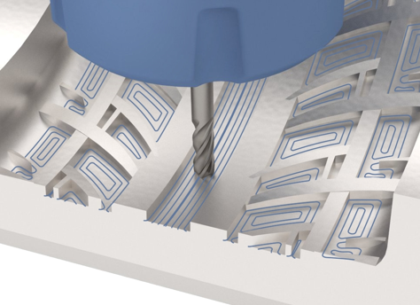
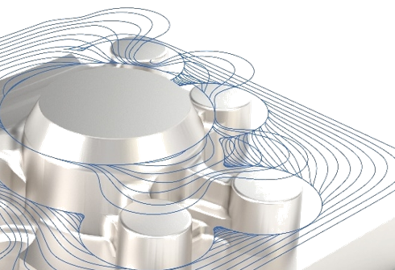
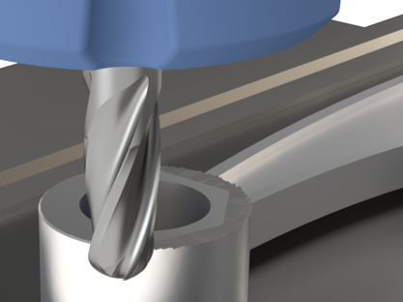
CREO HIGH SPEED MILLING ADVANCED EXTENSION
Rapid creation and computation of 3- and 5-axis high-speed milling sequences
Customers that requires 3- and 5-axis high speed machining capabilities for rapid production and manufacturing
High speed machining increases manufacturing efficiency and productivity
Creo High Speed Milling Advanced
Who Needs It?
New in Creo 8.0
Business Value
Accelerate time-to-market
Improve quality of manufactured products
Reduce development and manufacturing costs
Increase customer satisfaction and win new business
(3 and 5-axis HSM)
Expanded partnership with ModuleWorks Includes existing 3-axis HSM capabilities
Adds 7 new 5-axis HSM toolpaths
Process Improvement
Integral CAD/CAM supporting concurrent design and manufacturing
Automatic change propagation and associative update of NC toolpaths
Automated creation of manufacturing process documentation
Technology/ Capability
All the capabilities of Creo High Speed Milling
5 Axis High-speed milling (HSM) roughing, rest roughing, including automatic 3+2 axis roughing and rest roughing
3to5 axis high-speed milling (HSM) conversion for finish and rest finish toolpaths
5 axis auto deburring
Comprehensive holemaking
GPOST: NC Post-Processor generator

Slide 2
Creo Manufacturing Comparison Chart
 | Functionality | Prismatic & Multi-Surface Milling | Production Machining | Complete Machining | High Speed Milling | High Speed Milling Advanced | NC Sheetmetal
NC Machine type | 2 ½ Axis Feature Based Machining | ✔ | ✔ | ✔
 | 3 Axis Milling | ✔ | ✔ | ✔
 | 3 Axis High-speed Milling (HSM) Roughing, Rest Roughing, Finish and Rest Finish |  |  |  | ✔ | ✔
 | 5 Axis High-speed milling (HSM) Roughing, Rest Roughing, including automatic 3+2 Axis Roughing and Rest Roughing |  |  |  |  | ✔
 | 3to5 Axis High-speed Milling (HSM) Conversion for Finish and Rest Finish toolpaths |  |  |  |  | ✔
 | 5 Axis Auto Deburring |  |  |  |  | ✔
 | Basic Holemaking | ✔ | ✔ | ✔ | ✔ | ✔
 | Comprehensive Holemaking |  |  | ✔ |  | ✔
 | 3 Axis Trajectory | ✔ | ✔ | ✔ | ✔ | ✔
 | 2-4 Axis Turning |  | ✔ | ✔
 | 2-4 Axis Wire EDM |  | ✔ | ✔
 | Live Tooling for Turning (Mill/Turn) |  |  | ✔
 | 5 Axis Continuous Milling, including 5 Axis Trajectory |  |  | ✔
 | Multi-task Machining Synchronization |  |  | ✔
 | Dynamic Tool Axis Definition in Turning |  |  | ✔
Mfg. productivity tools | Extraction of Manufacturing Annotation Features | ✔ | ✔ | ✔ | ✔ | ✔
 | Tool and Fixture library | ✔ | ✔ | ✔ | ✔ | ✔
 | Manufacturing Process Documentation Pro/PROCESS for Manufacturing | ✔ | ✔ | ✔
 | Automatic Nesting |  |  |  |  |  | ✔
 | Punch Press and 2 Axis Laser Programming |  |  |  |  |  | ✔
Post & Sim. | Creo/NC-GPOST : NC Post-processor generator | ✔ | ✔ | ✔ | ✔ | ✔ | ✔
 | Moduleworks-based Material Removal | ✔ | ✔ | ✔ | ✔ | ✔

