Slide 1
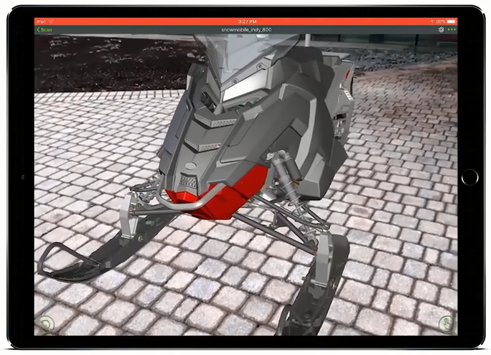
CREO AR DESIGN SHARE (NOW INCLUDED WITH CREO)
Easily create and securely share AR experiences managing models and viewer access
Who Needs It?
Every customer that needs to securely communicate, collaborate and share CAD data with engineers, suppliers, partners and non-CAD users
Fully control authoring and accessibility of your company’s AR experiences
Business Value
Enhance the customer experience using AR to visualize products in the real world
Enable virtual design collaboration using AR to facilitate effective design reviews
Solicit and apply expertise and knowledge using AR to connect disparate teams
Enable non-CAD users to interact, explore and engage using AR
Protect IP by preventing access to CAD data
Process Improvement
Design communication, collaboration and review
AR model and viewer administration
Technology/ Capability
AR Setup, Publishing, Distribution and Viewing via Vuforia View
Secure management of AR models and viewer access

