Slide 1
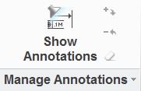
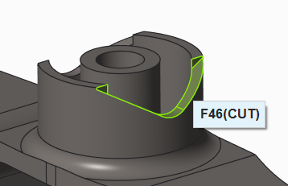
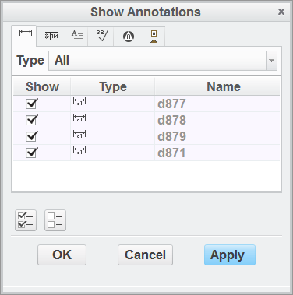
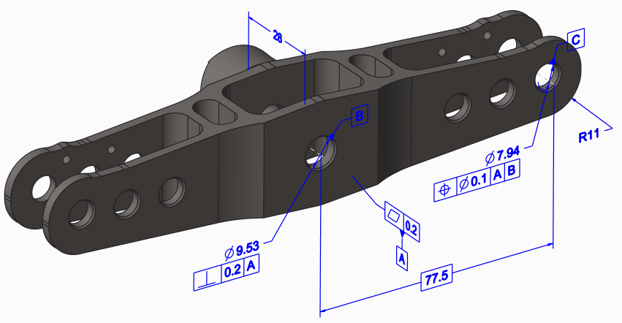
CREO PARAMETRIC – 3D MODEL ANNOTATIONS (aka MBD)
Define a single source of truth for design, manufacturing and process information
Who Needs It?
Customers that want to improve the documentation and sharing of digital product information for design review and manufacturing
The goal is to reduce reliance on 2D detailed drawings and eliminate lost time documenting non-critical information
Unlike 2D data, 3D information is easily visualized and interrogated
Business Value
Reduce time-to-market
Reduce product development cost
Improve product quality and innovation
Improve collaboration and communication
Process Improvement
Model-based documentation and GD&T
Streamline communication using a drawing-free process
Technology/ Capability
Streamline product documentation via drawing-free process
Eliminate human error and miss-interpretation of 2D information
Define a single source of product development and manufacturing information

