Slide 1
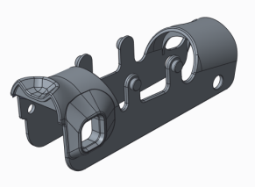
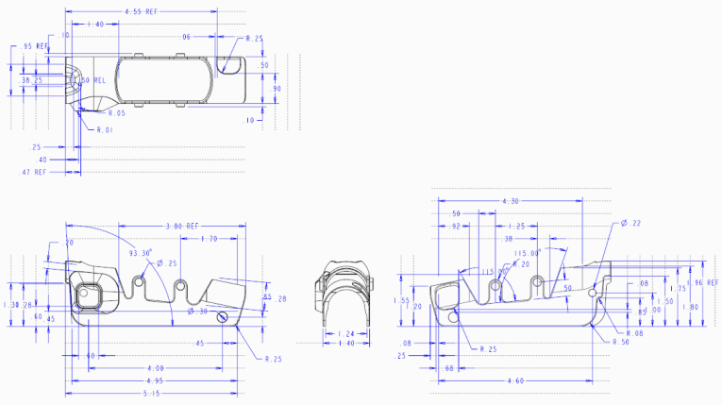
CREO PARAMETRIC – 2D DETAILING AND DOCUMENTATION
Simplified creation and documentation of detailed manufacturing requirements
Who Needs It?
Every customers that needs to document product specifications and manufacturing details
Business Value
Reduce product cost
Reduce time-to-market
Reduce product development cost
Process Improvement
2D drawing and documentation
Technology/ Capability
Automated creation of drawings using standard templates
Fast drawing “cleanup” of dimensions, notes and annotations
Automatic creation of associative BOMs
Automatic creation of views and balloon callouts
Easily creation of dimensions, geometric tolerances, annotations, etc.
Support for all industry standards (ANSE, ISO, ASME and JIS)

